Slide 1
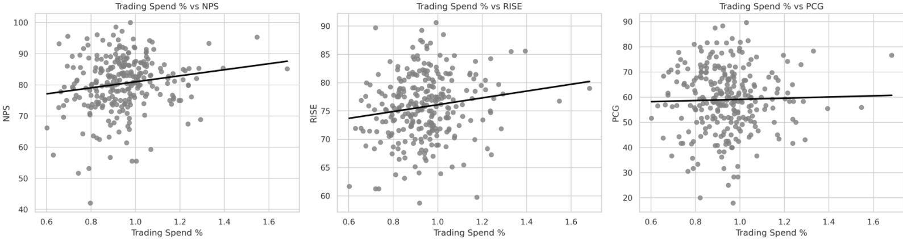
Customer performance v trading spend
Positive trading spend leads to improved customer experience
There is a clear link between trading spend and improved Customer Experience
Key Takeaways
Low Trading Spend (< 0.75%) is often associated with below-average NPS and RISE scores.
RISE shows the strongest correlation with spend, suggesting that the In Store Customer Experience may be more sensitive to investment levels.
100% spend
+14%
100% spend
+15%
Notes:
We also see a clear link between resourcing levels & not only Customer Experience performance but also commercial success…
September NPS & RISE v Trading spend %
There is a clear upward trend – regions spending more on labour tend to have higher customer satisfaction.
The data supports the potential for +14% NPS & +15% RISE movement for stores that underspend if they move to 100% spend
September PAYM conversion
Strong positive correlation – Regions with higher spend show significantly better conversion rates.

Slide 2
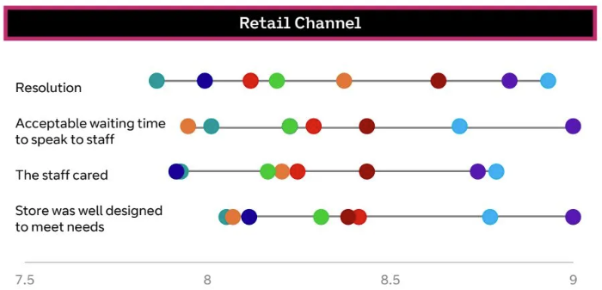
Customer performance – consumer insights
further scrutiny & next steps
Findings
External provider surveys approx. 5000 people per month.
Cascade approach to questioning.
Retail specific insights are based on approx. 100 responses per month.
Respondent demographic is skewed to older population.
Retail results indicate both EE & BT respondents.
Retail results out-perform other channels.
Retail involvement in full review of question set, demographic data and survey mechanic
Closer collaboration between the Consumer insights team & Retail
Next steps
Indicates combined scoring position
Notes:
Consumer Insights report scrutiny

Slide 3
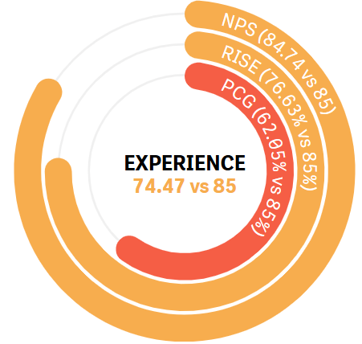
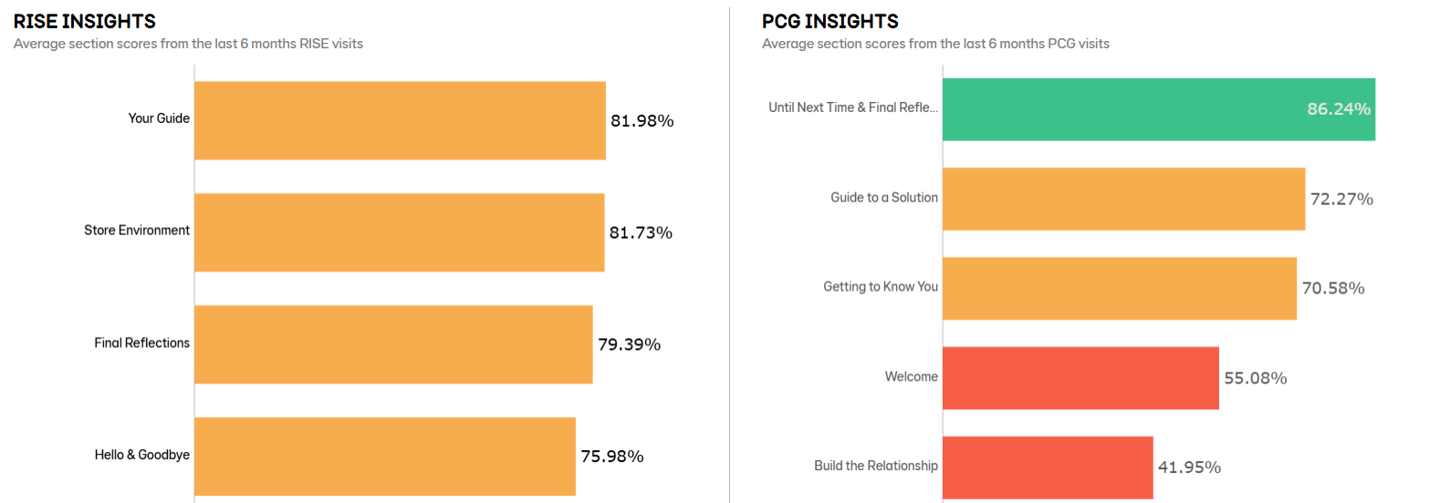
Customer performance – new measures
6-month average experience score remains level at 74.5%
Experience Level Flat
  North Level | South +0.1% | Franchise -0.2%
RISE rating of 77% improves 1% MoM
PCG score of 62% is Level MoM
NPS dropping back continues to impact the overall Experience score.
The RISE HBB scenario has the strongest score with an average of 80%
North
74%
Experience Rating – 6M ave.
South
72%
Franchise
78%
Your Guide + 5.1%
Final Reflections + 5.9%
Notes:
When looking at HBB scenarios
Your Guide scores 5.1% higher & Final reflections scores 5.9% higher – this could indicate a higher confidence level selling HBB.
Did the guide suggest relevant products & services +10%
Knowledgeable + 10%
Confident & Clear +8%.
Trust +10%
Personal +10%

Slide 4
Company owned
V franchise

Slide 5
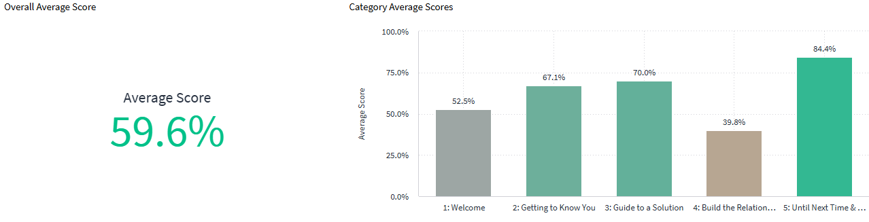
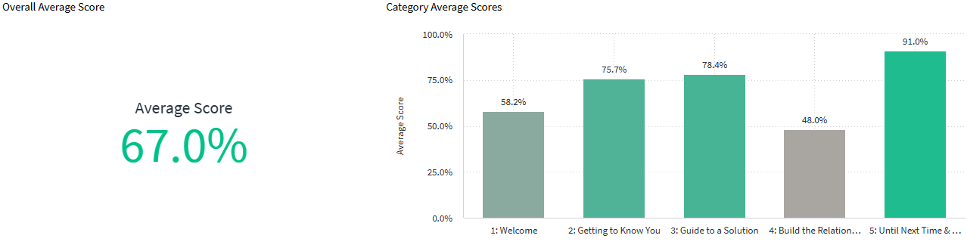
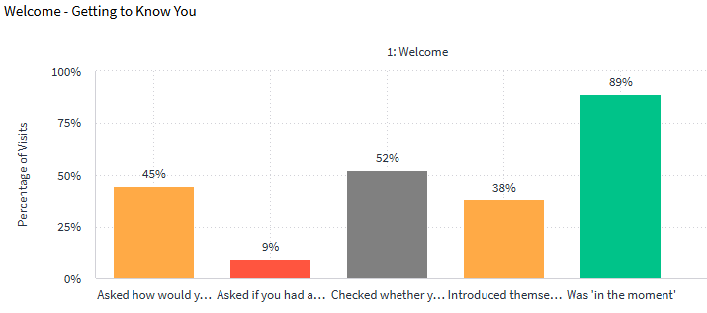
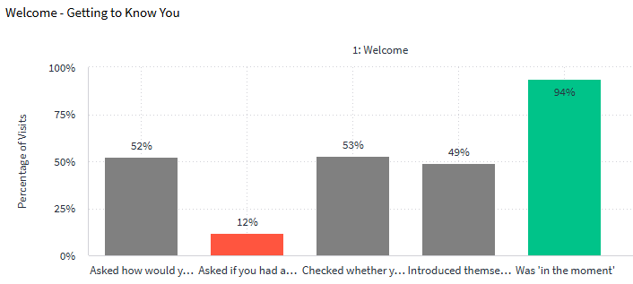
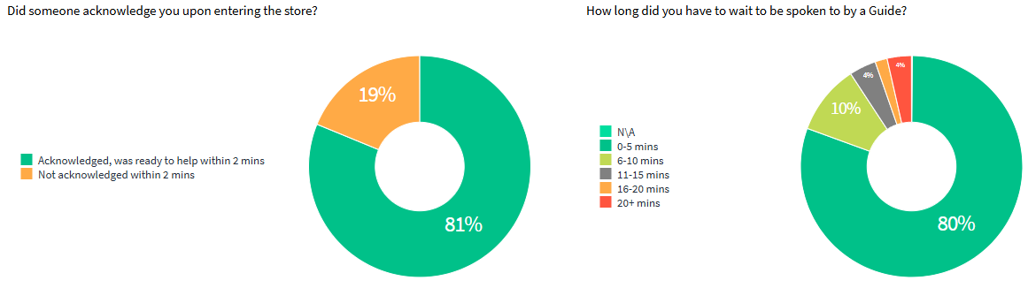
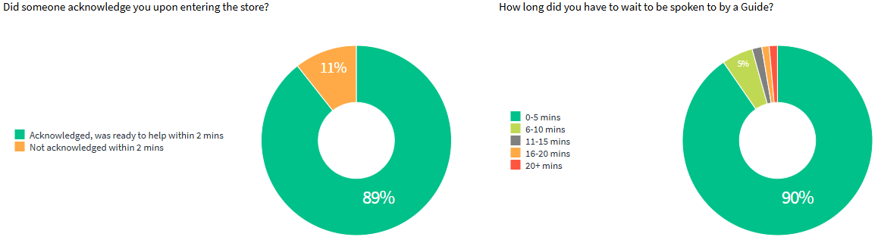
Company owned v franchise
Acknowledgment & handover time
Make the difference
Franchise stores outperform Company owned stores across all PCG categories.
Overall +7.4% Welcome +5.7% Build the Relationship +8.2%
With a focus on the Welcome, we see that Franchise are more consistent with acknowledging the Customer +8% as well as having shorter handover on average +10%
Company owned
Franchise
+7.4%
+5.7%
+8.2%
+8%
+10%
Notes:
Franchise stores outperform Company owned stores across all PCG categories.
Overall +7.4% Welcome +5.7% Build the Relationship +8.2%
With a focus on the Welcome, we see that Franchise are more consistent with acknowledging the Customer +8% as well as having shorter handover times on average +10%

Slide 6
Welcome erlt focus area

Slide 7





First Impressions Matter…
7 SECONDS
"From the moment we arrived, the staff greeted us by name and offered champagne. The concierge had already booked dinner for us based on our preferences. It felt like royalty.”
“Always greeted with a smile. Staff go out of their way to help, even fixing things they don’t officially offer. It’s the kind of service that makes you come back.”
“The branch staff are friendly and efficient. They make banking feel personal and stress-free.”
24%
41
STORES
100
STORES
135
STORES
GreetMe Stats
Stores that logged into GreetMe daily in September
Logged in fewer than 10 times in September
Have entered fewer than
1 customer per month
Have not entered a single customer into the queue

Slide 8




First impressions matter…
SHEPPER VISITS
TOP SCORING STORE YTD
100%
“The guide was really helpful, suggested booking via the app, and their friendly manner made me feel encouraged to return , it felt above and beyond.”
"I was not welcomed when I entered the store and I was not spoken to in the 20+ minutes being in the store, so I left."
SHEPPER VISITS
MID SCORING STORE YTD
55%
“Despite the store being busy, Callum prioritised well — offering seats and triaging questions before serving me. He handled the situation appropriately.”
"I was not acknowledged at all, and the staff didn’t know who was next in the queue”
SHEPPER VISITS
LOWEST SCORING STORE YTD
17%
8%
The top 100 scoring stores vs the bottom 100 scoring stores have an 8% difference in conversion
“The guide was friendly and helpful, suggesting I book via the app next time. I felt encouraged to return , a standout experience.”
"The colleague was scrolling on his phone, he then saw me. His face didn't look too happy, It wasn't the most welcoming."

Slide 9
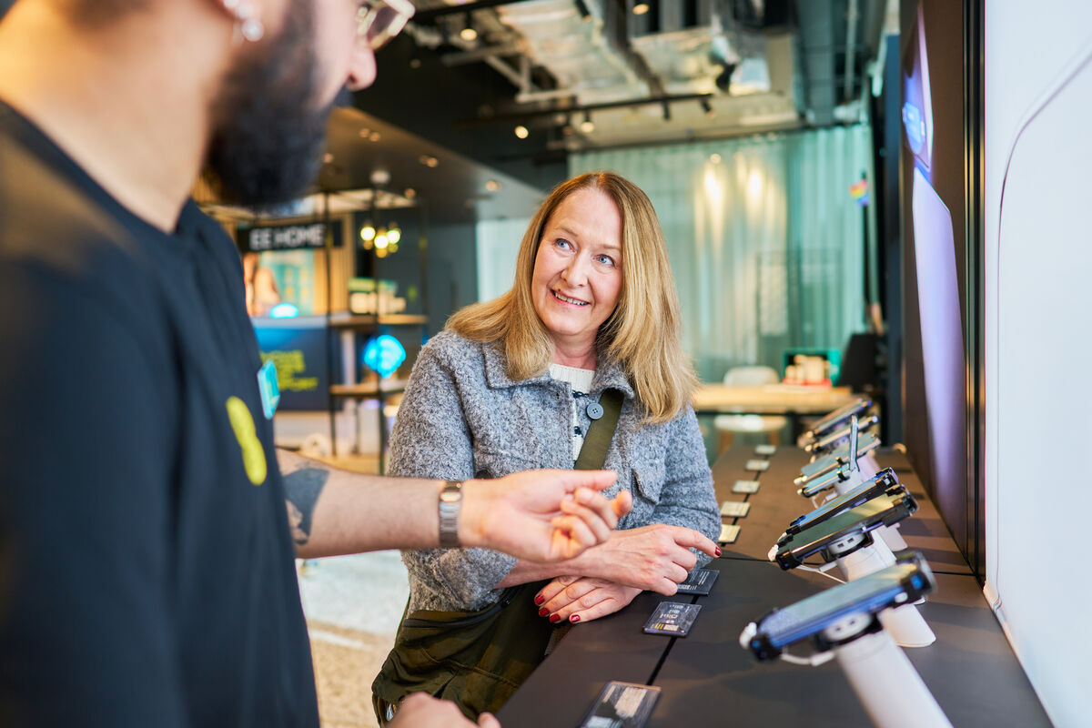


Roles and Responsibilities of the World class Welcome
Role | Responsibilities
Store Leaders | Create welcome plans with Store Leaders. Role-model world-class welcome, especially when busy. Be visibly present to show that leaders lead the welcome. Give feedback based on welcome observations. Use and role-model GreetMe during visits.
Store Leaders & Senior Guides | Observe, coach, and give feedback. Manage shop floor flow and coverage. Assign a Welcome Guide daily based on store needs. Set clear expectations for the Welcome Guide role. Use time-managed cover when no dedicated Guide. Role-model ideal Welcome behaviours. Use GreetMe to track and close appointments.
Guides | Greet, queue via GreetMe, and personalise welcome. Be ready to step into the Welcome Guide role. Stay alert to front-of-store security risks.

Slide 10


Choose Your World Class Welcome Flow
Pick the welcome approach that best fits your store’s capacity. flexible options, same great experience.
No. of colleagues on the Shopfloor
Below 3
3-5
Over 5
Quiet Periods
Next available
Welcome Guide
Assigned Welcome Guide FOH at all times
Assigned Welcome Guide FOH at all times
Busy Periods
Greet from your seat
Next available
Welcome Guide
Assigned Welcome Guide FOH at all times
Type of Guide | Definition
Greet from your seat | The Welcome Guide may not be available to be able to greet at the front of the store but they should always be acknowledging people coming into store even if they’re with a customer. Whether that’s verbal acknowledgement or just a smile and eye contact.
Next available Welcome Guide | The Welcome Guide role flexes, when one serves, the next available Guide steps up to lead the welcome.
Assigned Welcome Guide FOH at all times | The Welcome Guide is always positioned at store front, and is accountable for all of the Welcome Guide tasks such as greeting, GreetMe management, winning handover, etc

Slide 11


When?
Daily world class Welcome Routine
When
Pre-shift
Morning
Lunch/Break
Afternoon/Evening
Store Leader assigns Welcome Guide role
Store Leader ensures Welcome Guide role is always covered
Store Leader goes through Welcome Brilliant Briefings
Store Leader assigns Guides to existing appointments
Store Leader ensures behaviours are being upheld with observations and feedback
Store Leader ensures smooth switch over of the Welcome role between Guides
Store Leader and Regional Leaders role-model the world class Welcome behaviours
All Guides to login to GreetMe
Welcome Guide manages GreetMe appointments—scheduling, closing, and setting customer expectations

Slide 12
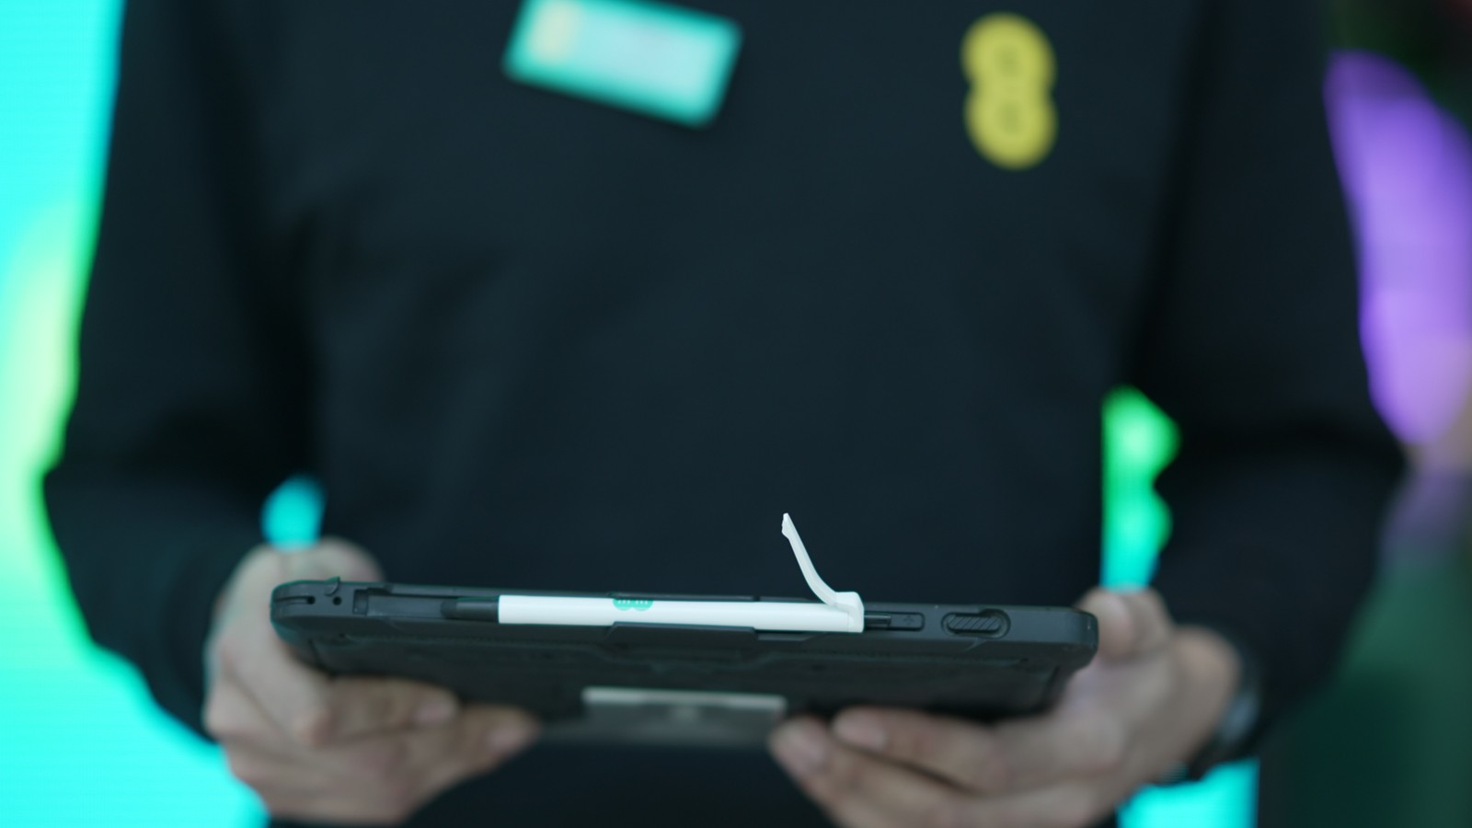
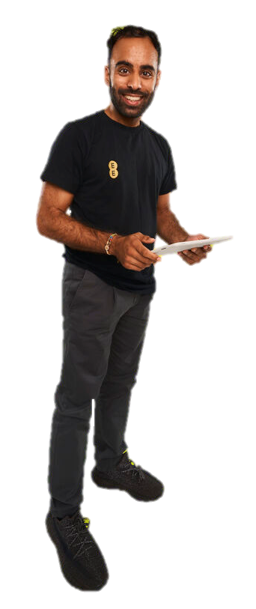






Welcome guide Accountabilities
Acknowledge promptly – Greet every customer within 30 seconds
great first impression – Stay visible, smile, and use open body language
Manage expectations – Communicate wait times and queue position
Manage GREETME – Check in & book out customers, know wha is due in
Deliver winning handovers – Introduce customers with context and warmth
Promote engagement– Encourage the use of DiscoverEE and browsing

Slide 13



Core commitments
The Non-Negotiable actions everyone should take. Flexible positioning but Consistent experience.
What do you think the Core Commitments for the World Class Welcome are?
Must acknowledge a customer within the first 30 seconds of entering the store – even if that’s a verbal hello or a smile of acknowledgment
Remain visibly active and engaged in light tasks during quiet periods to ensure the store appears welcoming and lively
Ensure GreetMe is used to enhance the Welcome that fits your store type
Always give their name and use the customers name
Provide a winning handover wherever possible
Manage customer expectations on any wait times, promoting and/or DiscoverEE usage during customer dwell time
Be mindful of spoken and body language used within store
Check in on interactions and ensure every departing customer receives a genuine thank you and goodbye.

Slide 14
Welcome guide – world class welcome roadmap
WEEK
1
WEEK
2-3
WEEK
4
FROM NOW ON…
Getting stores ready
GreetME logins – ensure all store team members are able to log in to the greetme portal
Store leader support packs – these will be sent out to all store managers and will have supporting documents to help you envisage and record your welcome journey
Creating your plan
Regional leaders will support their store leaders in utilising pack contents to create their welcome journey plan and record it
Pack will include :
Choosing your welcome flow
Defined roles and accountability
Key stages of the welcome journey
Accountabilities of the welcome
guide and store leader
Template for recording your welcome journey
Implement and observe
Stores will receive ‘brilliant briefings’ to deliver in pre-shift briefings
Store teams will start using their redenied welcome journeys
Store leaders and regional leaders will role model the behaviours agreed
Store leaders and regional leaders will complete observations and provide feedback to guides
Welcome is for life not just for golden quarter
Welcome will continue to be a focus for all stores.
We must ensure that guides continue to understand the correlation between a world class welcome, customer satisfaction and sales performance
The retail leadership team will continue to observe and feedback on welcome during their store visits

Slide 15
Welcome flow
Front of house Welcome Guide
Approaching the Store
Entering the Store
Dwell
Time
Winning Handover
Context story, RISE usage etc
Use this template to create you’re your welcome plan stage by stage, from the point of view of the customer.
What do they see, hear and feel?
Notes:
Worksheet for RLs to complete breakout

