Slide 1
Managers Meeting
31st January 2025

Slide 2
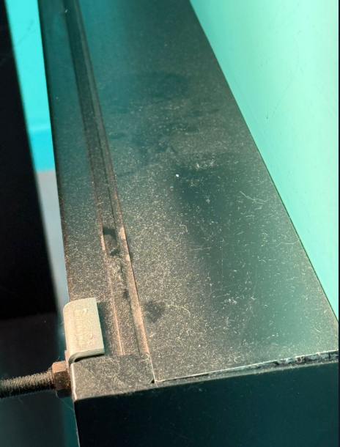
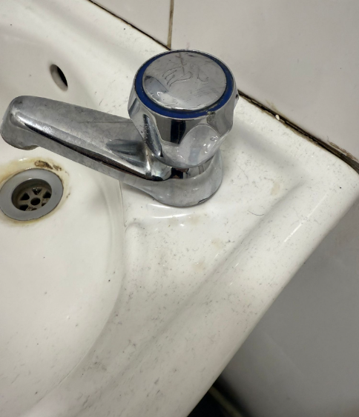

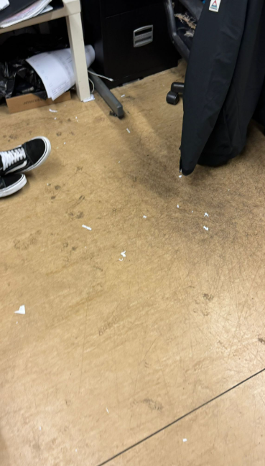
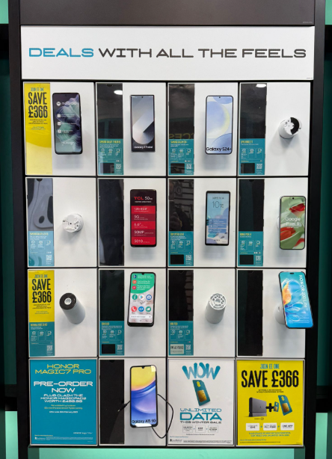
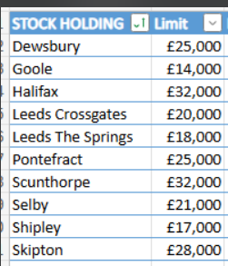
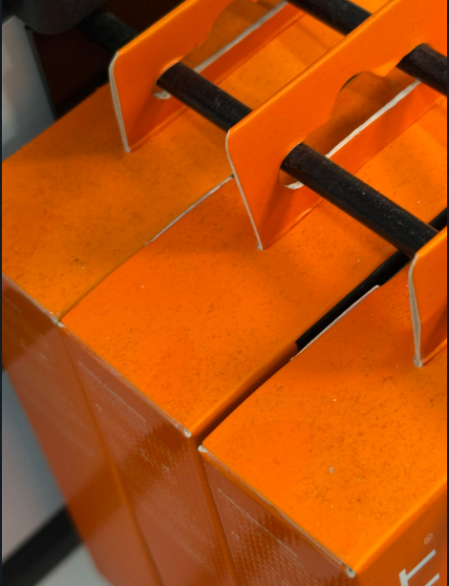

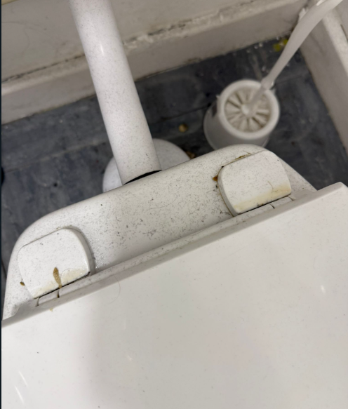
Operation & Compliance
POBO/Flexpay Warehouse Sales
From 1st March 2025 we will be introducing a £10 admin fee for all warehouse fulfilled sales, including POBO & Flex Pay Warehouse Stock.
POBO sales will have an additional £10 (ex VAT) invoiced for each transaction alongside the POBO.
Flex pay Warehouse stock will see a reduced handset fee for each connection (£20 down from £30).
EE has historically picked up all costs associated with the picking, packaging and delivery of these devices to stores, the costs of which have increased substantially since POBO was introduced.
STOCK Limits =
Operation Overview (Store Standards)

Slide 3
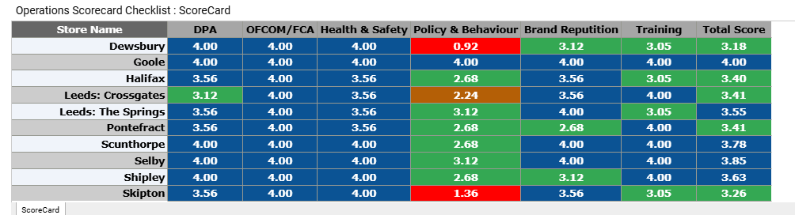
Ops Scorecard
The most common issue across your visits:
Missed deadlines
Failure to complete required tasks on time.
Staff Sign outs
This includes:
Missed Training Deadlines: Managers and staff not completing training by the required dates.
Missed Submission Deadlines: Employee evaluation forms, manager action plan presentations, meter readings.
Checklist Failures: Daily operational checklists, particularly PED checks, not being completed on time before store opening.
Resolutions
Prioritize Tasks: Start each day by creating a clear list of the most important tasks (e.g., training deadlines, checklist completion, store openings). Ensure these are completed first. Set Reminders: Use your phone or a task management app (like Google Calendar, Trello, or Asana) to set reminders for key tasks, like PED checks, training deadlines, and daily reporting. This will help you stay on top of your responsibilities.
Time Blocking: Set aside specific times in your day dedicated solely to completing key tasks (e.g., completing daily checklists or submitting reports). Protect this time from distractions.

Slide 4
SME – PAYM/BB
Pam

Slide 5
LUNCH

Slide 6
SCORE CARD/WILDCARD
SME PAYM – Added as a Extra Secondary
The measure will be verses company owned (excluding RTP sales). This will appear in the scorecard mid month and be backdated to 1st Feb.
Wildcard
From 1st February, the below metrics will replace the current New Verticals:
Payg (vs 0.50% ambition)
EEasy Lead (verses company owned)
Sky Stream (verses company owned)
Home Security (verses company owned)
Performance Tracking
Any AMBERS in Primary EOM = ROC (1 Strike)
Any REDS in Primary EOM = ROC (2 Strikes)
Any REDS in Secondary EOM = ROC (1 Strike)
Poor Performance of any Wildcard KPI’s by EOM = ROC (1 Strike)
3 ROC’s in a 3 Month Period for SC will result in Performance Plan

Slide 7
Pay as you Go
We still have an active market for PAYG and we need to keep these customers shopping with us rather than sending onto another company to serve. 70 stores across Franchise on zero sales Jan.
Whilst PAYM Acq will be a recommended option for the customer, we need to be ready to offer this to customers who want it.
Everyone must know:
How To Top UP a customer
How to Process a New PayG Sim
How to Process a New PayG Handset
How to Upgrade a Payg Handset
PayG Tariffs
Why PayG
All Stores Must have the Compliant PayG POS Out (Tent Cards/Desk Stickers)

Slide 8
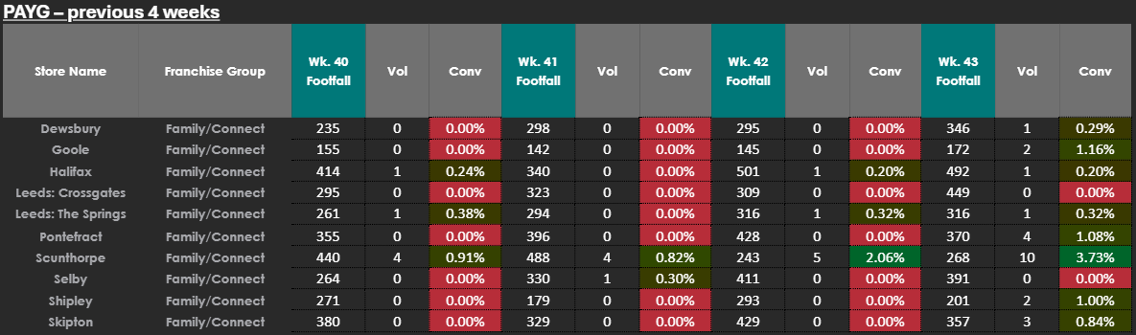
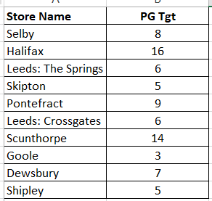
Targets:

Slide 9
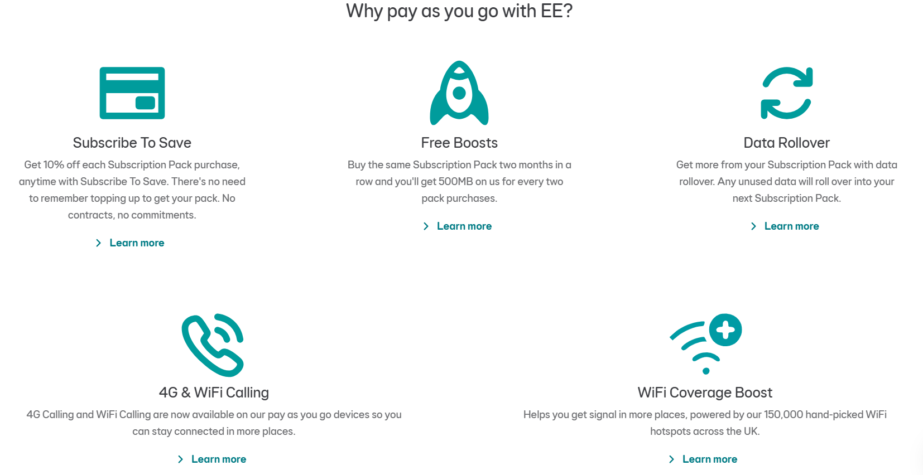

Slide 10
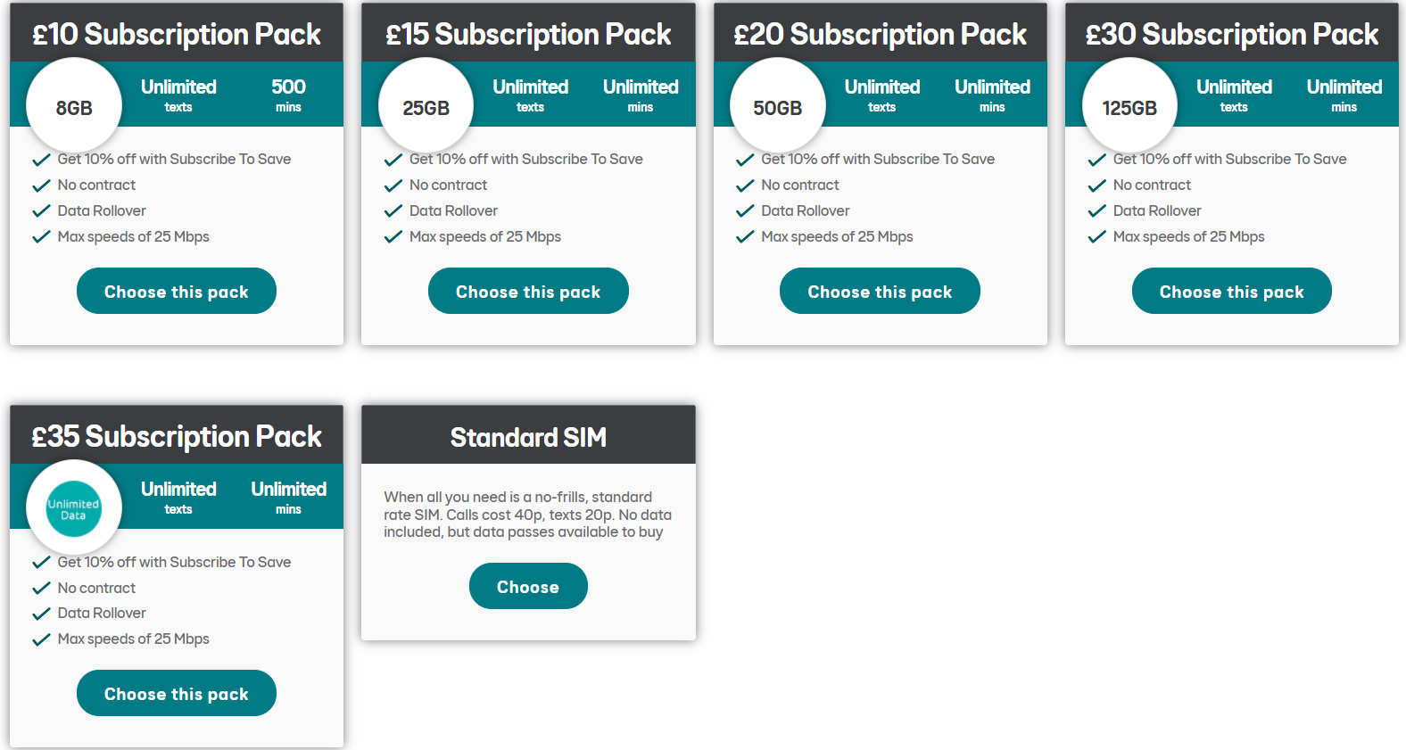

Slide 11
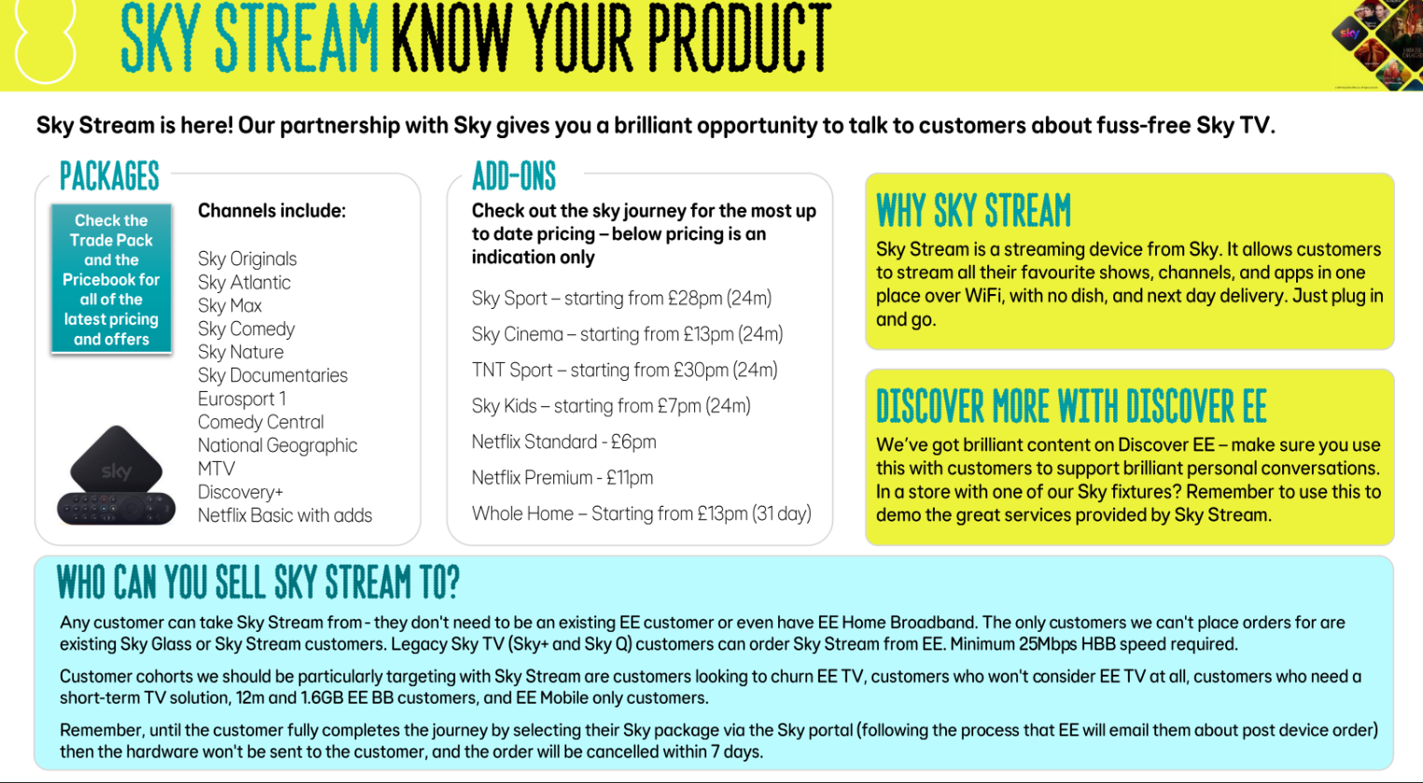
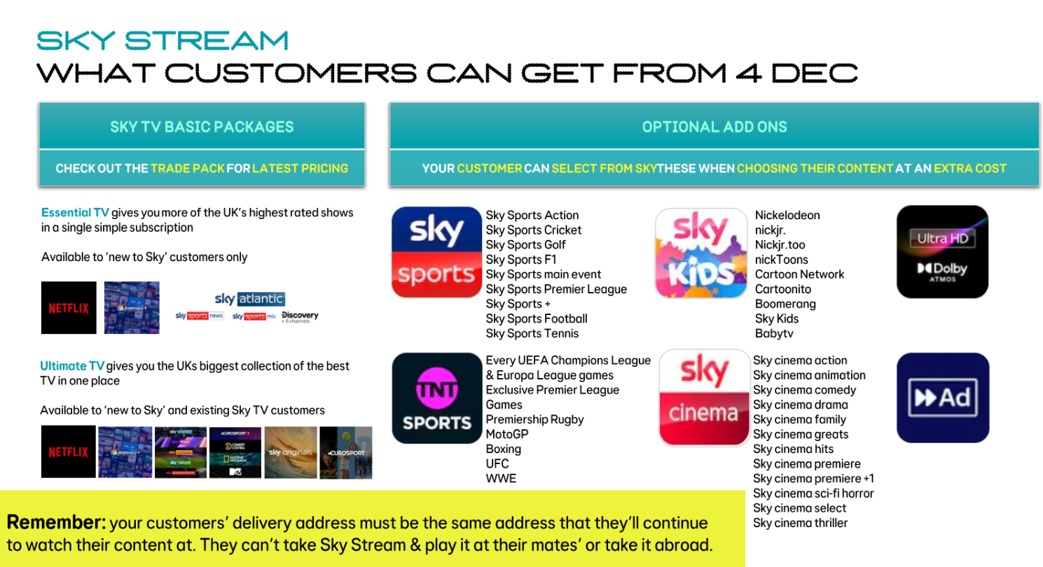

Sky

Slide 12
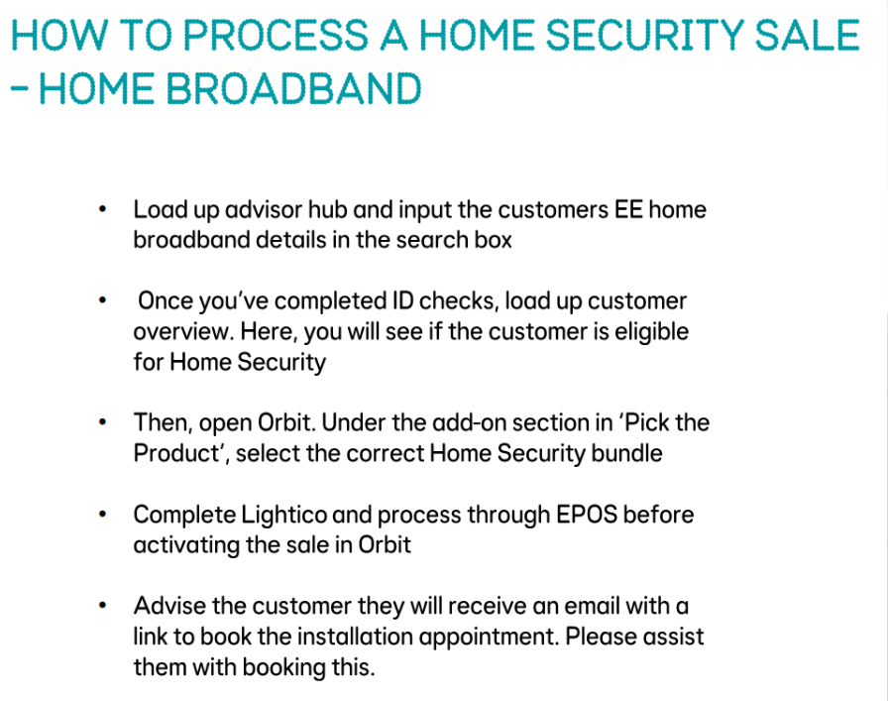
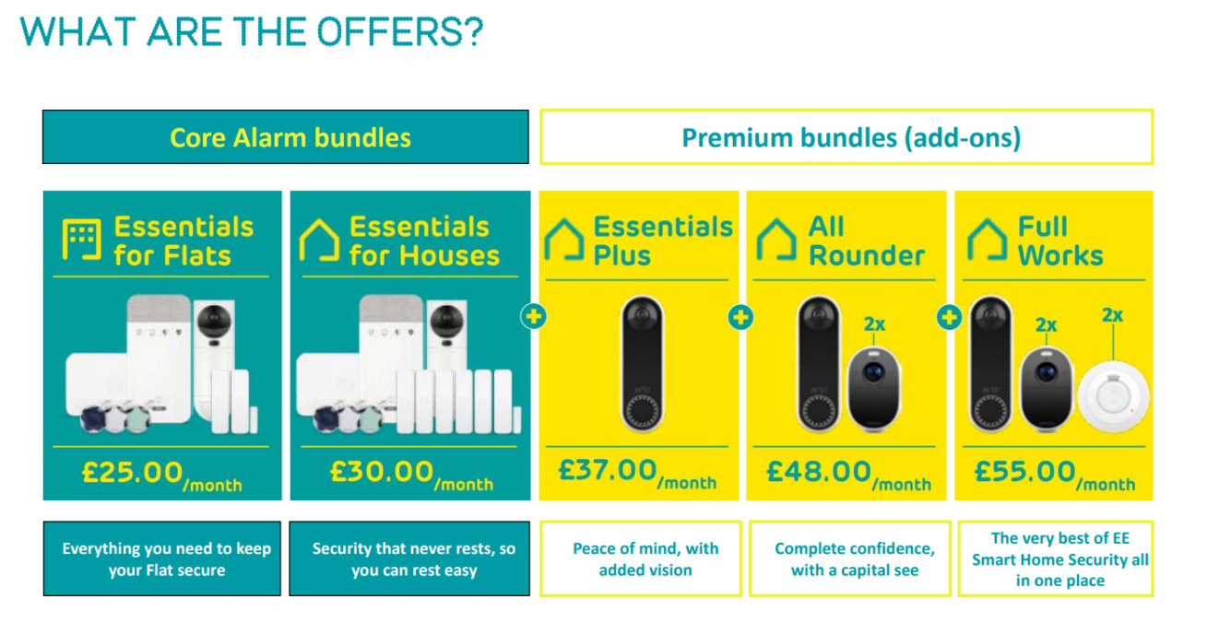
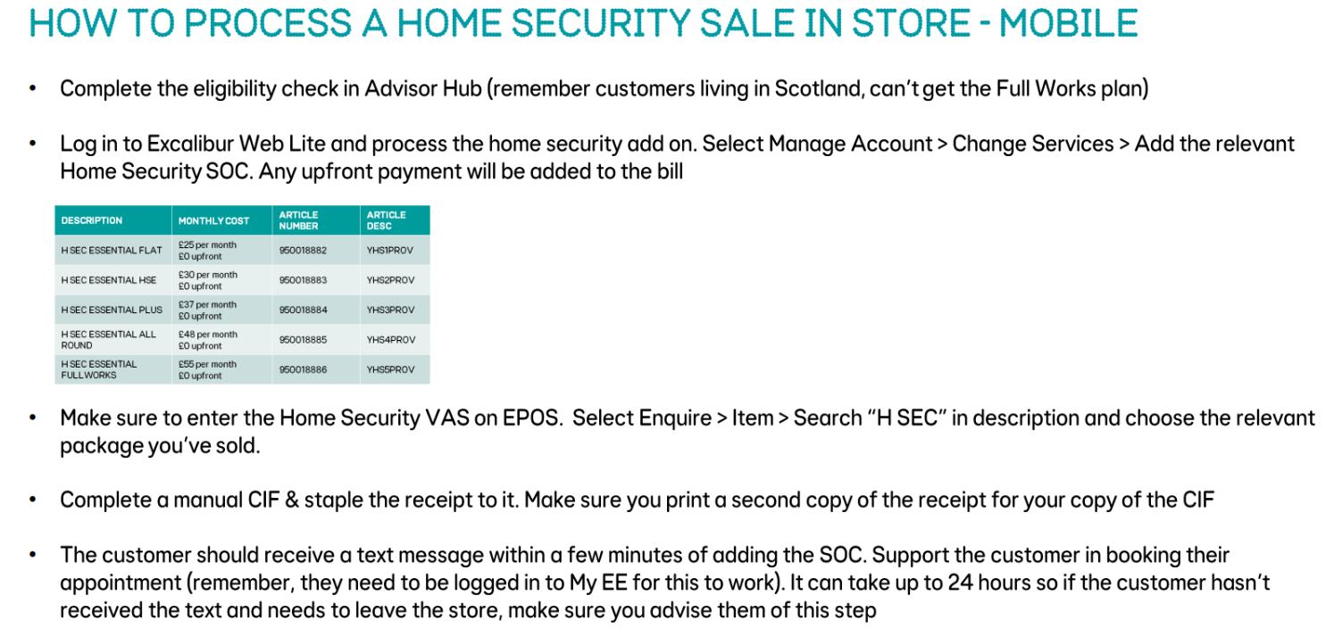
Home Security

Slide 13
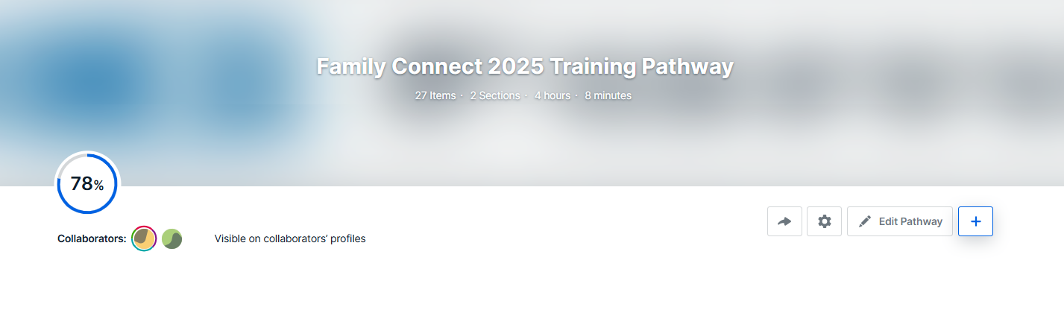
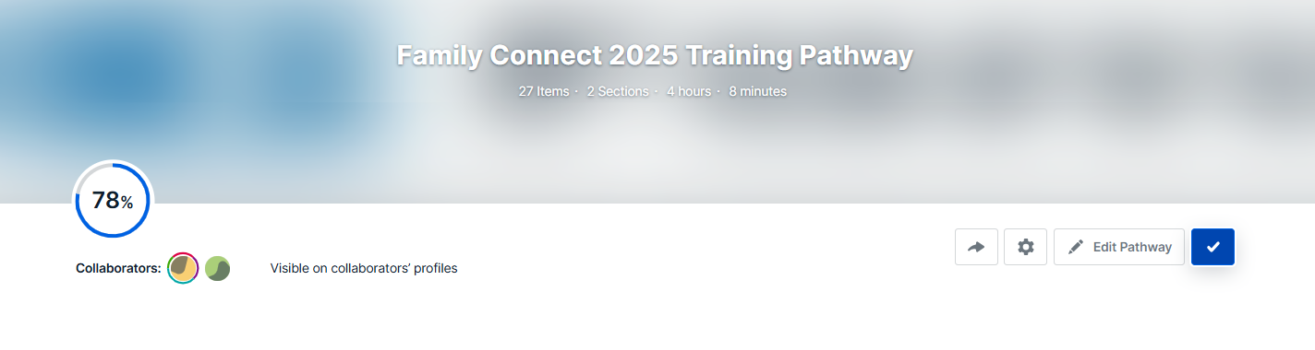
Training

Slide 14
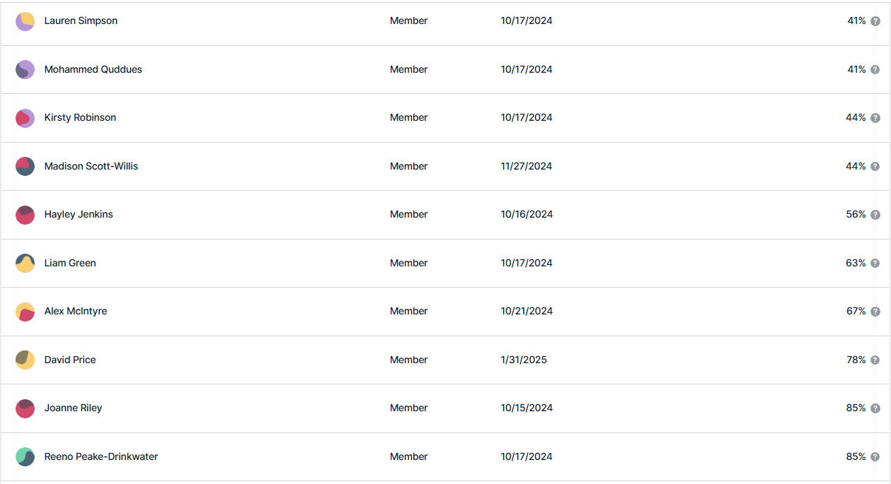
Training – Deadline Missed

Slide 15
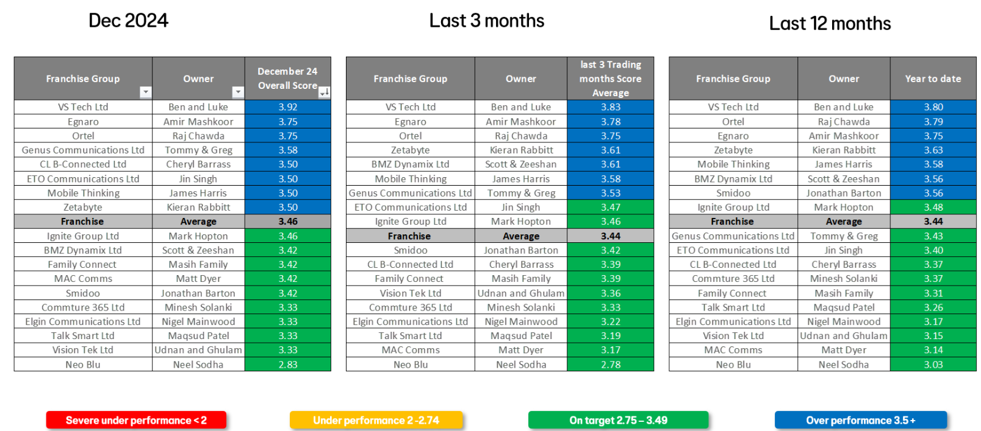
JAN = 3.58

Slide 16
Wage Increase
18 to 20 - £11.50
21 and Over – £12.50
Senior - £13.00
Managers = Will be discussed Individually
Letters will be going out to everyone this month so please make sure your teams are aware to keep an eye on emails, as these documents need to be signed as its an amendment to contracts

Slide 17
Targets
Targets have been generated for the year
We still have the right to amend throughout the year
Profit targets are non negotiable
We have Made a Review on the targets based from the current performance in January

Slide 18
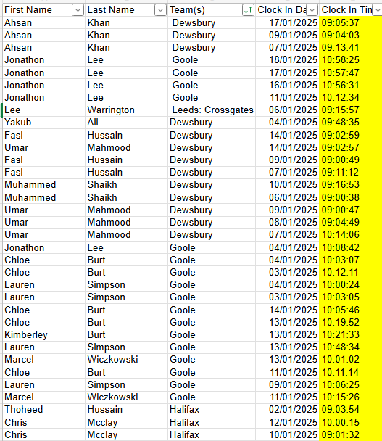
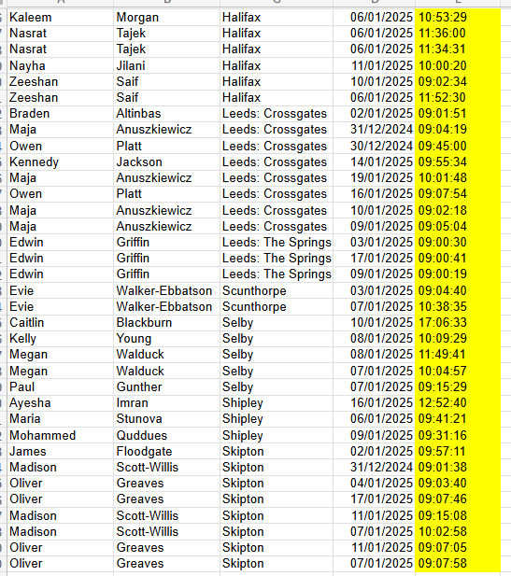
Lateness
Week1
Week2

Slide 19
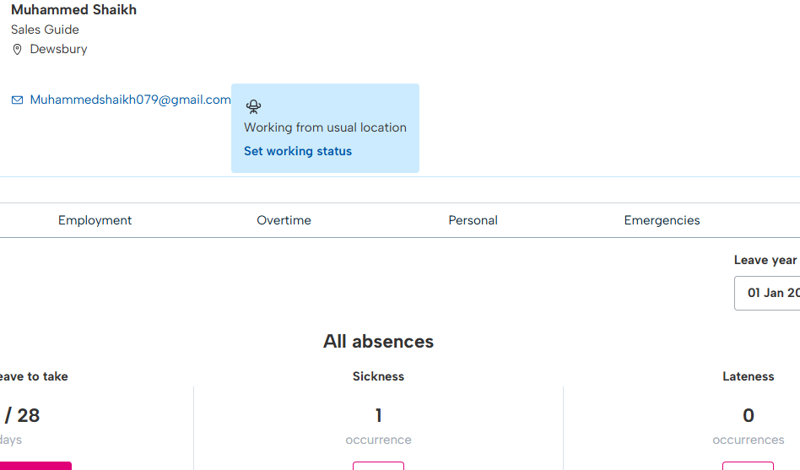
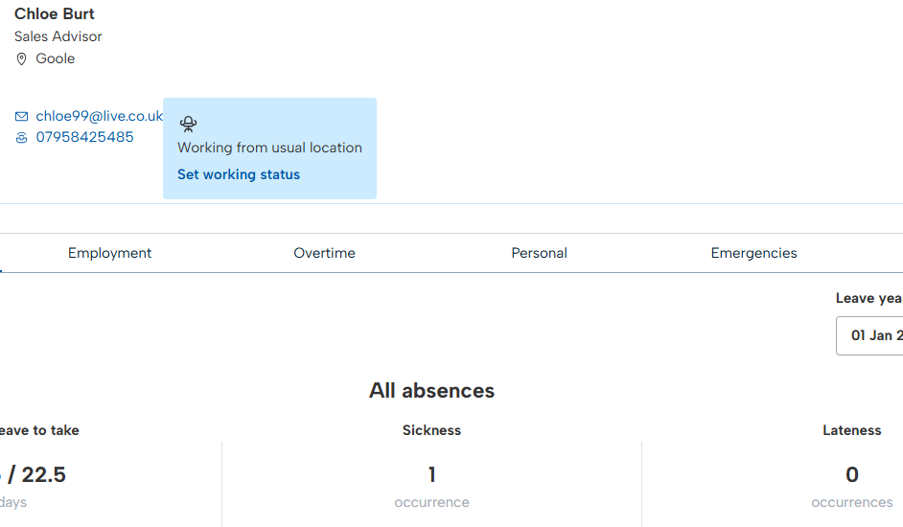
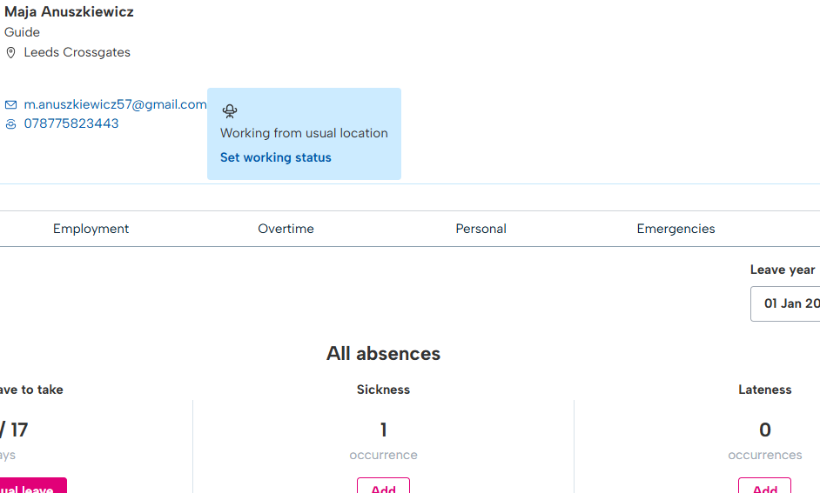
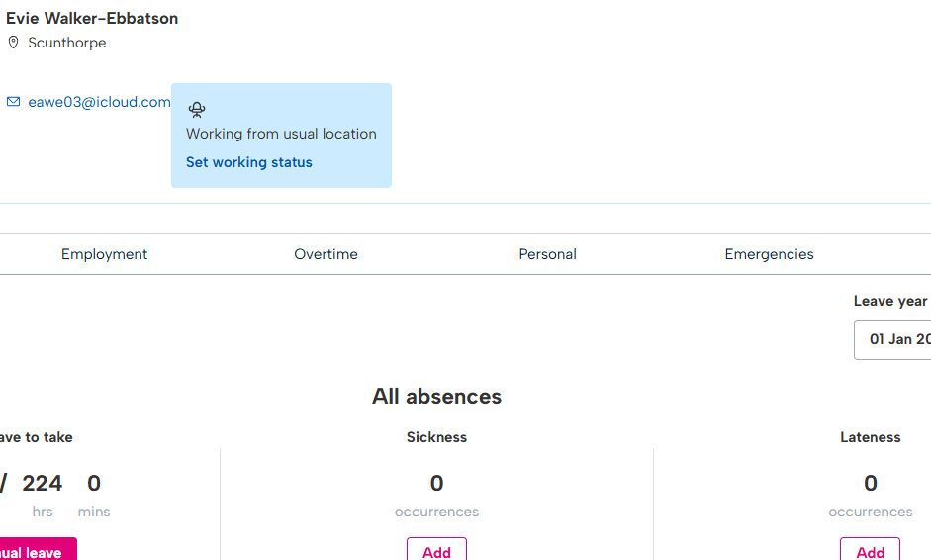
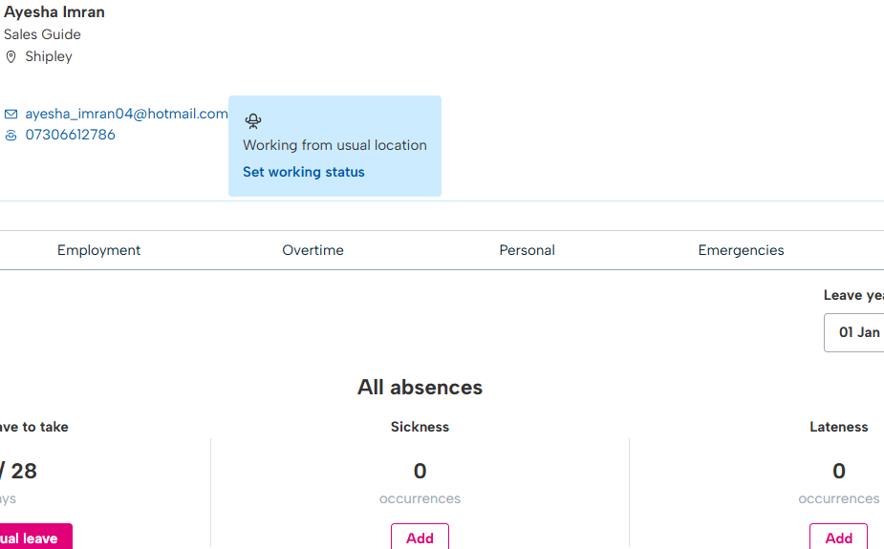
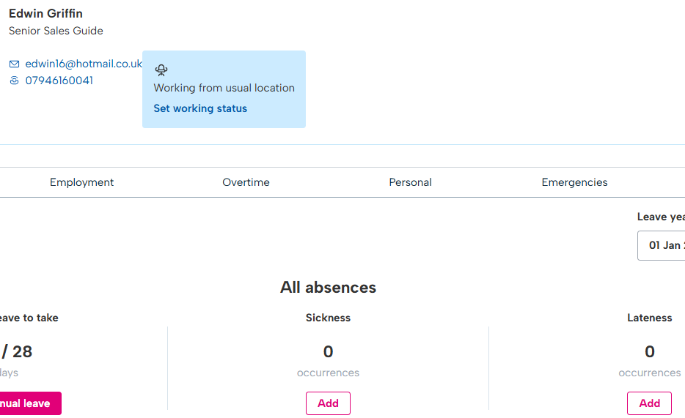
Lateness
Well Done Sally, Both Lateness’s in January were Correctly Recorded

Slide 20
Mystery Shop
Old Programme has now Finished
Shoppers are actually customers going forward
They are not continually looking at the sales journey
They can be between 7 and 14 visits a month to get more of a reflection
Visits can be on Anything, Store Standards, Processes, API, A specific deal etc etc
February Shops are on PayG & Digital Voice
Reports will be sent to RM’s
MS Commission suspended will be reviewed once we know more on the results

Slide 21
AOB
Rota, 3 Months Rolling must be on Bright HR, (only two stores have this correct)
Staff Reviews must be done with each employee before 7th of the new Month.
All guides are required to be in store 15 mins prior to there Shift
All Managers are Required to be in 20 Mins prior to there shift
BLIP must be used at all times, its your responsibility to make sure your staff have clocked in and out correctly, any mistakes MUST be Adjusted.
AL same rules apply, we need at least 50% Leave booked by end of June, anyone that is on AL must not be in the ROTA for the same time Period.
Banner – Orders are to be kept to a limit, we have already rejected 2, a lot of items can be sourced cheaper locally, if so use POP to claim back this expense.
Window Cleaners – we are reviewing this currently and looking to introduce this as a part of the stores cleaning process, each store will receive a Window Cleaning Kit and it will be the managers responsibility to make sure the windows are Cleaned Weekly.

Slide 22
Thank You

