Slide 1
STORE AND VISITOR LOG
WE’VE GONE DIGITAL

Slide 2
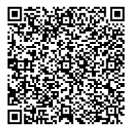
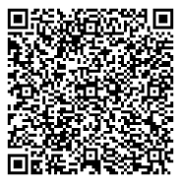
The Apps
Staff and Visitor Log Mobile app
Staff and Visitor Log Tablet app
What’s the difference?
Use the mobile app for everyday signing in, breaks and signing out on your mobile
This can, also, be used for any visitors. If your visitor works for EE/BT, they can use their own phone.
The tablet app allows you to sign people in and out retrospectively.
Use the Staff and Visitor Log Tablet to complete your quarterly declaration checks

Slide 3
THE MOBILE APP

Slide 4
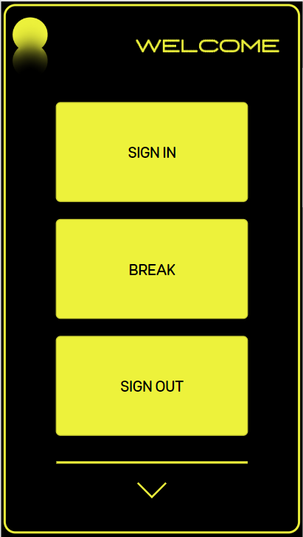
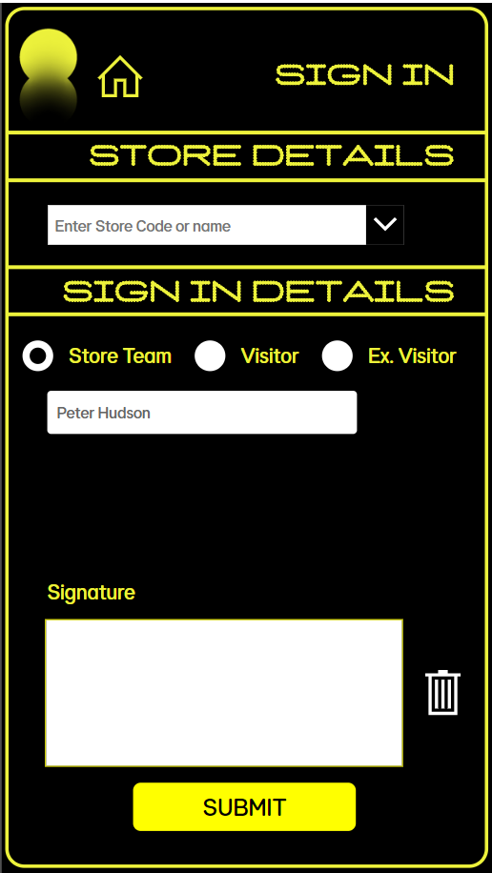
SIGNING IN (STORE TEAMS)
Open the Mobile app using the QR code or searching ‘Staff and Visitor Log mobile’ in Powerapps. Select ‘SIGN IN’
Don’t worry if you don’t have Powerapps on your phone, you can access the app on a store tablet
Enter your store code and select your store, your name will be pre-selected, sign in the signature box and select ‘SUBMIT’
(Don’t worry if you make a mistake, just hit the erase button)

Slide 5
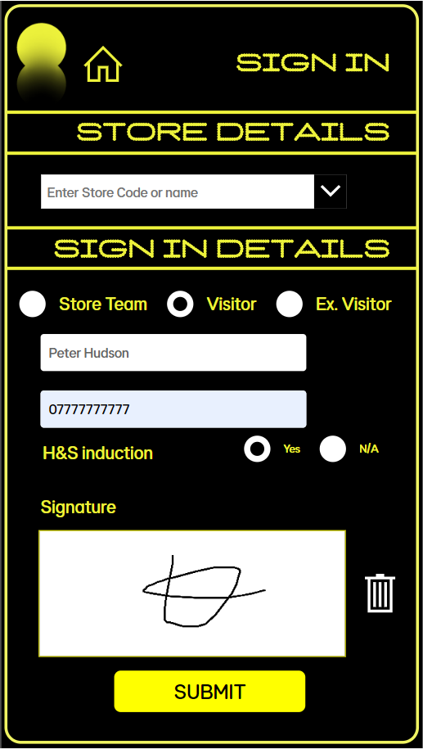
SIGNING IN (EE/BT COLLEAGUES)
Enter the store code and select the store visiting, your name will be pre-selected. Select ‘Visitor’, enter a contact number, select if a H&S induction has been completed, sign in the signature box and select ‘SUBMIT’
(Don’t worry if you make a mistake, just hit the erase button)
Open the mobile app using the QR code or searching ‘Staff and Visitor Log Mobile’ in Powerapps. Select ‘SIGN IN’
Don’t worry if you don’t have Powerapps on your phone, you can access the app on a store tablet

Slide 6
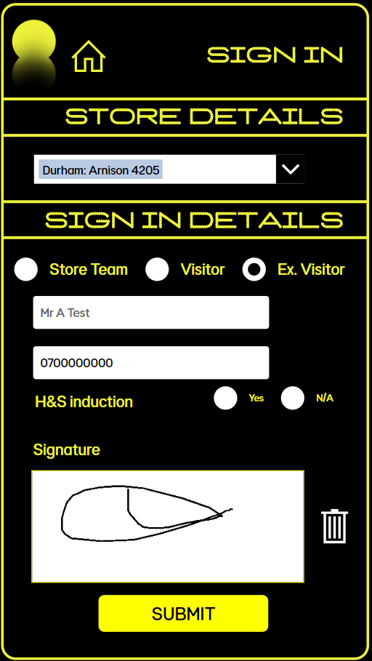
SIGNING IN (EXTERNAL VISITORS)
Enter the store code and select the store visiting. Select ‘Ex. Visitor’, enter the visitors name enter a contact number, select if a H&S induction has been completed, ask the visitor to sign in the signature box and select ‘SUBMIT’
(Don’t worry if you make a mistake, just hit the erase button)
Open the Store Team app using the QR code or searching ‘Staff and Visitor Log Mobile’ in Powerapps. Select ‘SIGN IN’
Don’t worry if you don’t have Powerapps on your phone, you can access the app on a store tablet

Slide 7
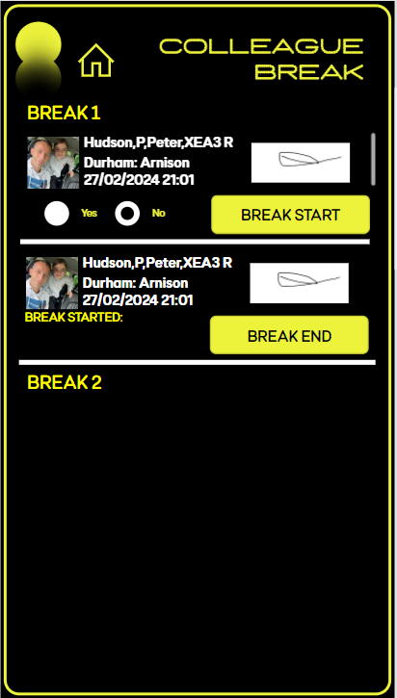
GOING ON A BREAK
Select ‘BREAK START’ in ‘BREAK 1’ when going out on your break and ‘BREAK END’ when you come back
BREAK START
When it’s time for a break, open the app and select ‘BREAK’
06/01/2024 18:37
BREAK END
You will see the time your break started here

Slide 8
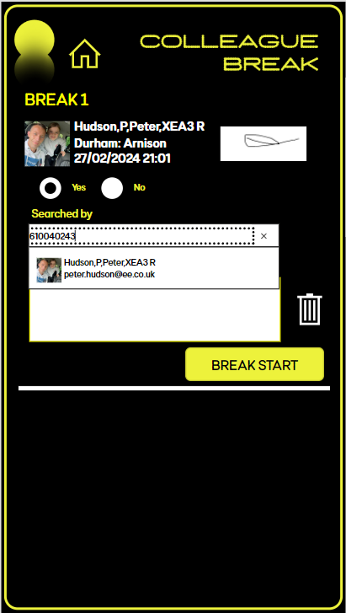
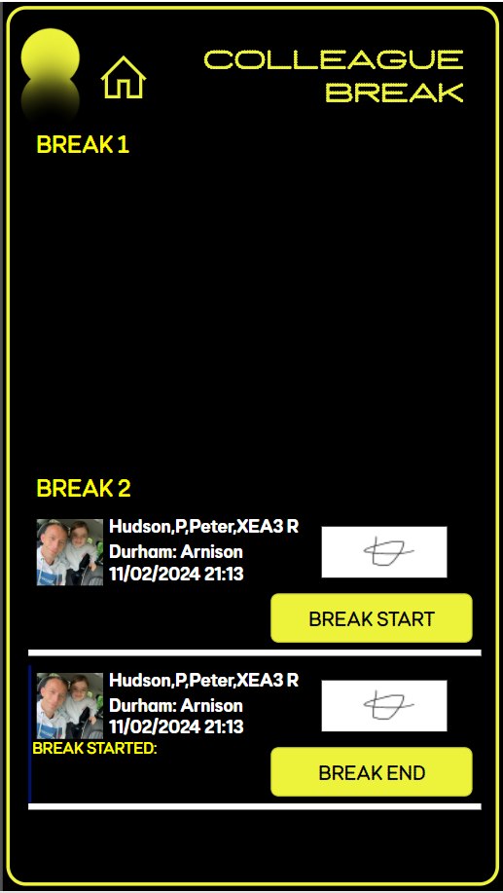
GOING ON A BREAK
Present yourself to a team member for a search. Ask the team member to enter their UIN and sign to confirm a search has been completed
BREAK START
If you’re going out for a 2nd time, select ‘BREAK START’ in ‘BREAK 2’ when going out on your break and, ‘BREAK END’ when you come back
BREAK END
BREAK START
06/01/2024 18:37
BREAK END

Slide 9
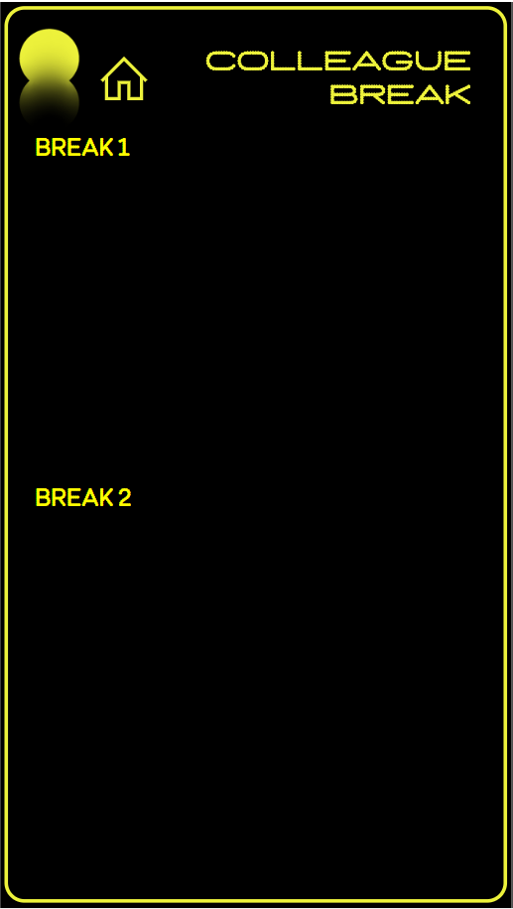
GOING ON A BREAK
If going out for a 3rd time, please sign out and sign in when returning

Slide 10
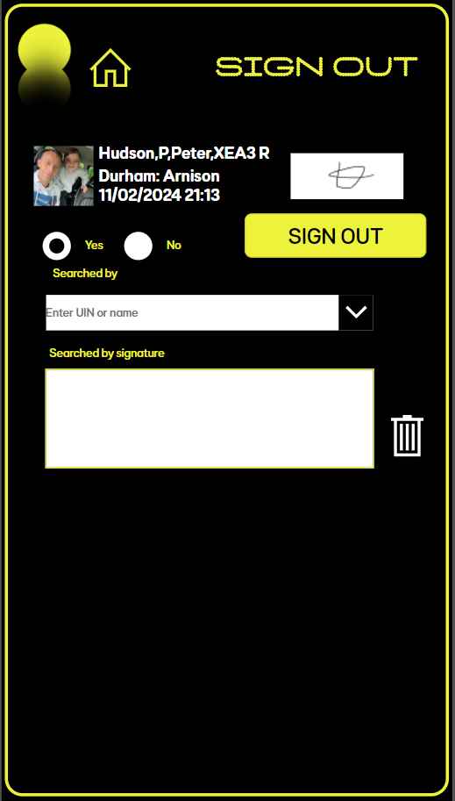
SIGNING OUT (STORE TEAMS)
If a search is not needed, ‘No’ will be preselected.
If a search is needed, select ‘Yes’ and ask a team members to enter their UIN and sign to confirm a search has been done. Then select
‘SIGN OUT’
If it’s time to go, open the app and select
‘SIGN OUT’
(Remember to present yourself for a search. If a search needs to be done, this can be completed using this app)
Searched

Slide 11
SIGNING OUT (INTERNAL VISITORS)
Present yourself to a team member for a search. Ask the team member to enter their UIN and sign to confirm a search has been completed
If it’s time to go, open the app and select
‘SIGN OUT’
(Remember to present yourself for a search)
Searched

Slide 12
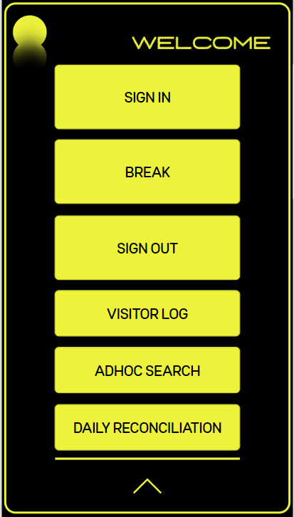
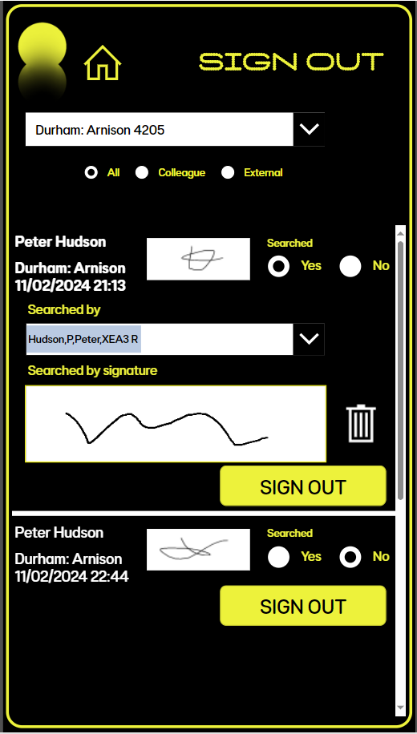
SIGNING OUT (EXTERNAL VISITORS)
Enter your store code or name.
Scroll through the log or select ‘Colleague’ / ‘External Visitor’ to search. Confirm a search is needed, enter your UIN and sign to confirm a search has been completed
When a visitor is ready to go, open the app, select the down arrow to open the admin menu and select
‘VISITOR LOG’

Slide 13
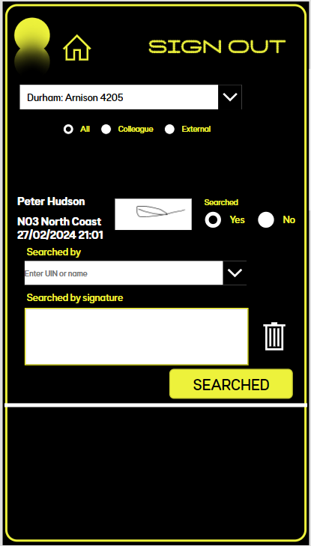
ADHOC SEARCHES
Enter your store code or name.
Scroll through the log or select ‘Colleague’ / ‘External Visitor’ to search. ‘Searched’ will be pre-selected, enter your UIN and sign to confirm a search has been completed
If an adhoc search is needed, open the app, select the down arrow to open the admin menu and select
‘ADHOC SEARCH’

Slide 14
THE TABLET APP

Slide 15
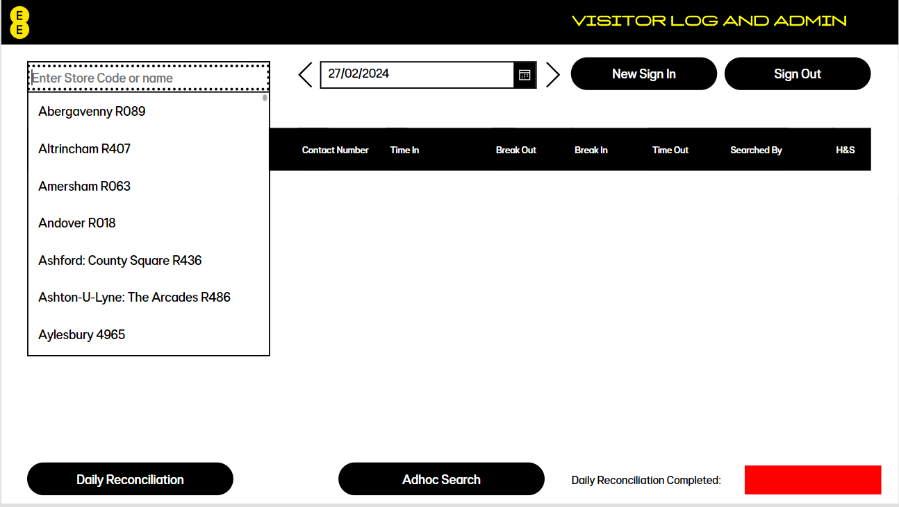
LOGGING IN (VISITORS & ADMIN)
Enter your store code
Once you’ve scanned the QR code or searched ‘Staff and Visitor Log Tablet’ in Powerapps, select your store to check your Visitor Log and daily reconciliation
The date will default to today’s date. You can check previous days completion by using the navigation icons or selecting a different date at the top

Slide 16
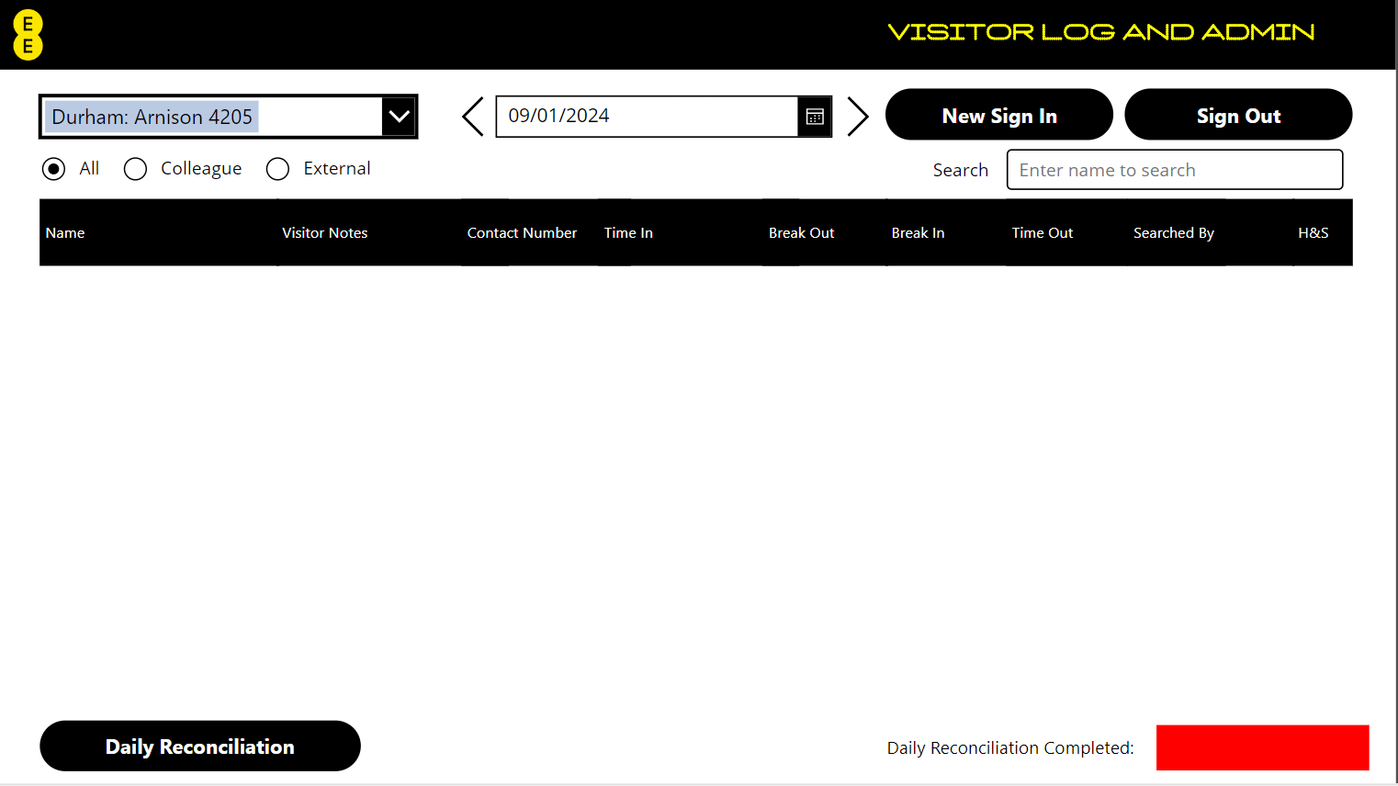
VISITOR SIGN IN
Select ‘New Sign In’
Adhoc Search
Internal and External visitors who don’t have access to Powerapps will need to use the Staff and Visitor Log Tablet
If a visitor comes into store, follow the relevant checks detailed in the ‘Sign In and Search’ policy then scan the QR code or search ‘Staff and Visitor Log’ in Powerapps to sign them in

Slide 17
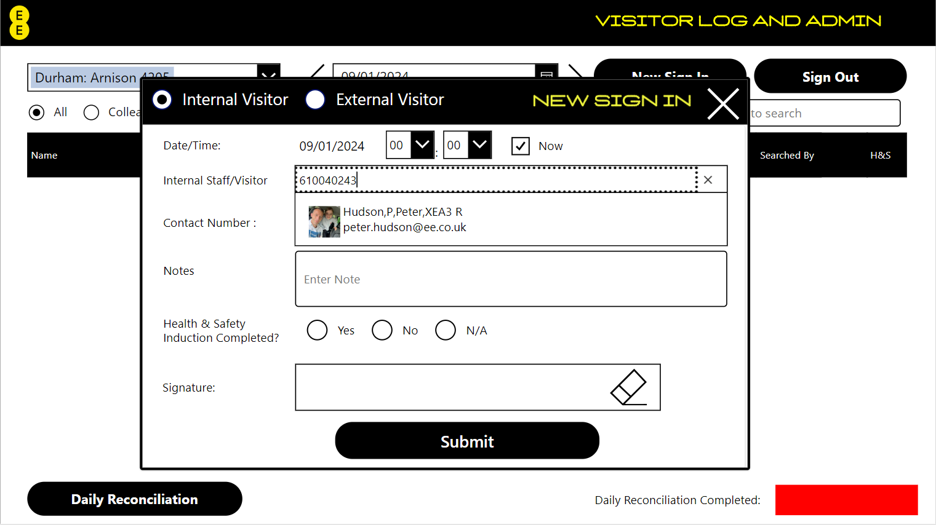
INTERNAL VISITOR SIGN IN
Select ‘Internal Visitor’
If signing in after arriving, uncheck ‘Now’ and select the time of entry
Type in the visitors UIN or name and select
Adhoc Search
Make sure that either ‘Now’ or an earlier time is selected when signing a visitor in
Failing to do this will cause the incorrect time to be recorded
All internal visitors should have pre-booked appointments in Greet Me, if not, follow the guidelines in the ‘Sign In and Search policy

Slide 18
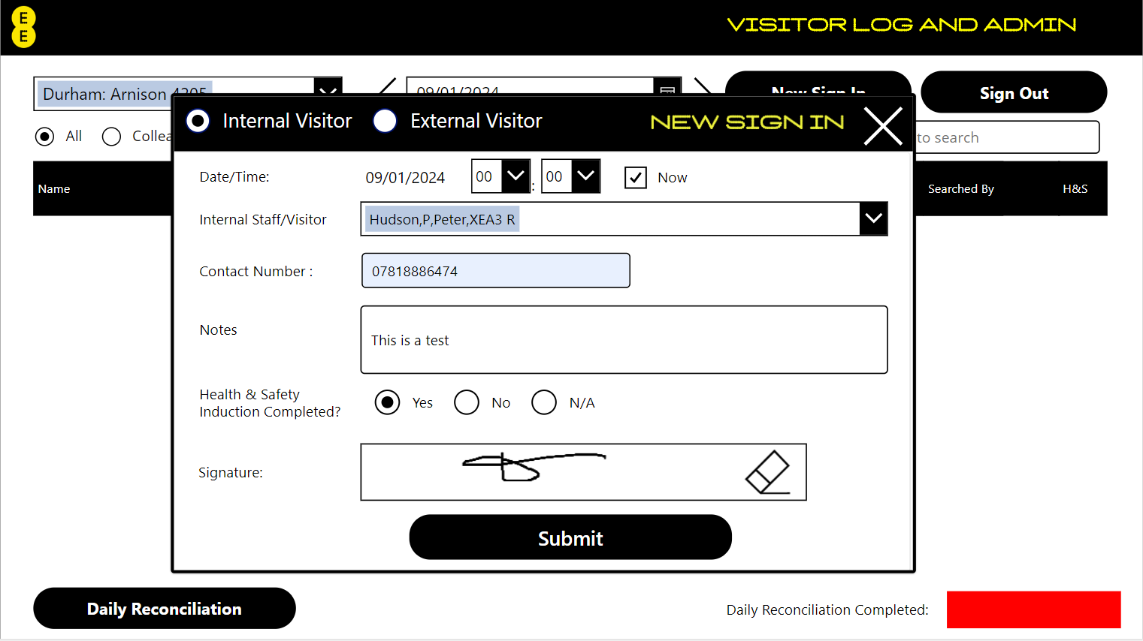
INTERNAL VISITOR SIGN IN
Record a contact number, the reason for visit in the notes, complete a H&S induction (if needed), ask your visitor to sign in the box and select ‘Submit’
(If they make a mistake don’t worry, just hit the erase icon)
Adhoc Search
New visitors must have a Health and Safety induction completed
This can be found on Albert under ‘Sign In and Search’ policy or by following this link:
Health_and_Safety_Site_Induction_Sheet.pdf (e-gain.s3.amazonaws.com)

Slide 19
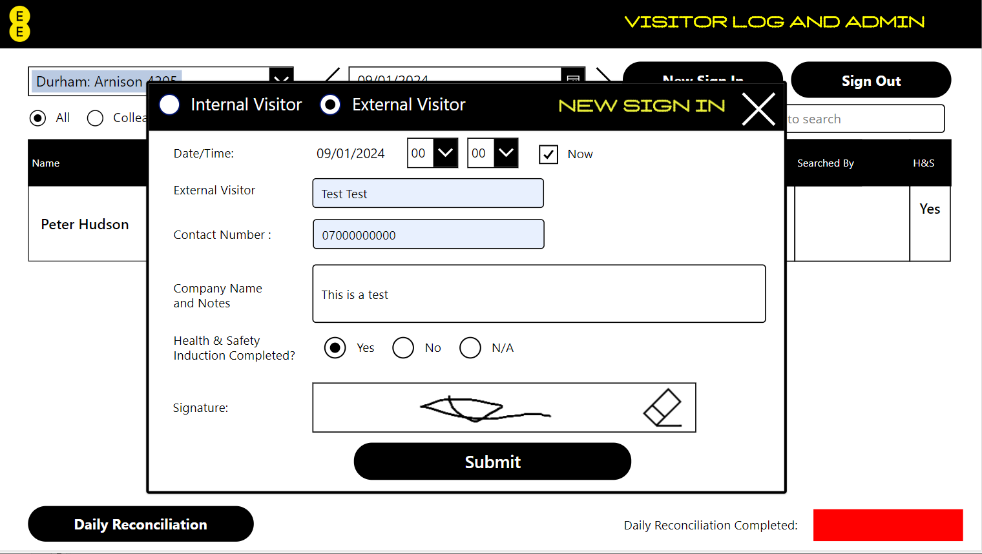
EXTERNAL VISITOR SIGN IN
Select ‘External Visitor’
Record your visitors name, a contact number, the company name in the notes, complete a H&S induction and ask your visitor to sign in the box
(If they make a mistake don’t worry, just hit the erase icon)
Adhoc Search
All external visitors must have a health and safety induction completed
Make sure that either ‘Now’ or an earlier time is selected when signing an external visitor in
Failing to do this will cause the incorrect time to be recorded
Please make sure that the company name is recorded in the notes

Slide 20
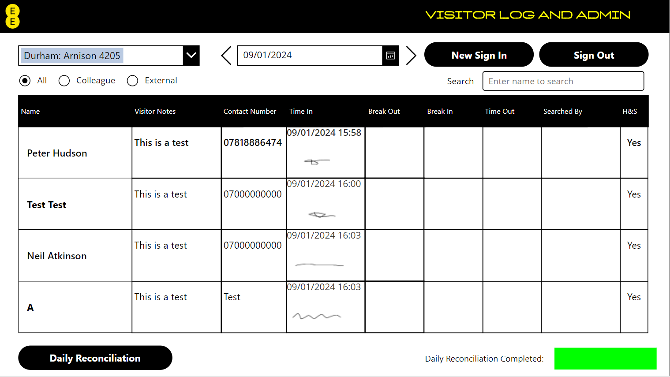
THE LOG
All sign in details and signatures are displayed on the log
Confirmation that the daily reconciliation has been completed will show on the previous day
Adhoc Search
Notice that the Daily Reconciliation Completed box turns green for the previous day when completed.
Use the date picker to check previous day completion.
All sign in details are displayed on the log including name, notes and contact number (for visitors), time in and signatures

Slide 21
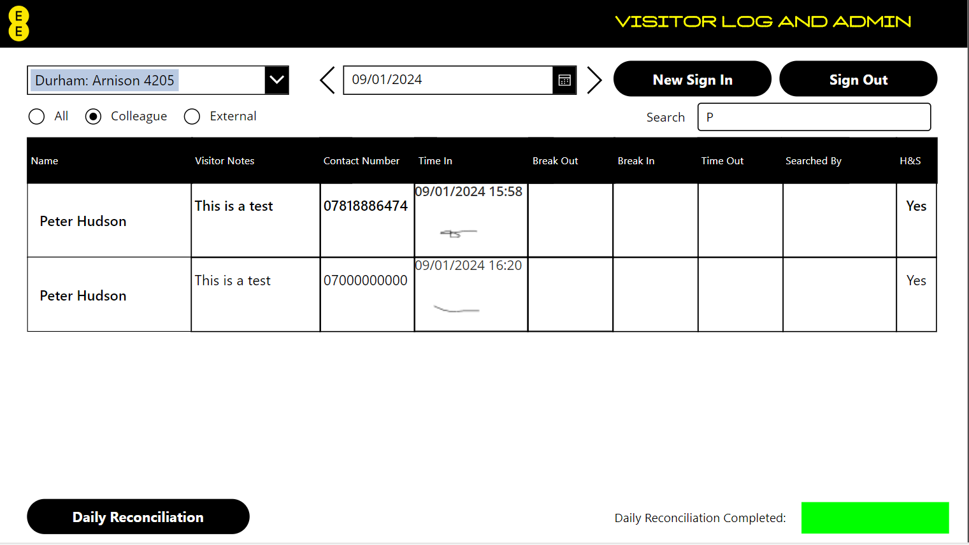
THE LOG
Either scroll or search for colleagues by selecting ‘Colleagues’ and start typing the name in the ‘Search’ box
Adhoc Search
The search box will only search once ‘Colleague’ or ‘External’ has been selected
Scroll through the visitor log or use the search box
You can select ‘Colleague’ or ‘External’ to choose who you want to search for

Slide 22

ADHOC SEARCH
Adhoc Search
Select ‘Adhoc Search’
Select ‘Sign Out’ to sign out visitors or to back date the sign out for a team member

Slide 23
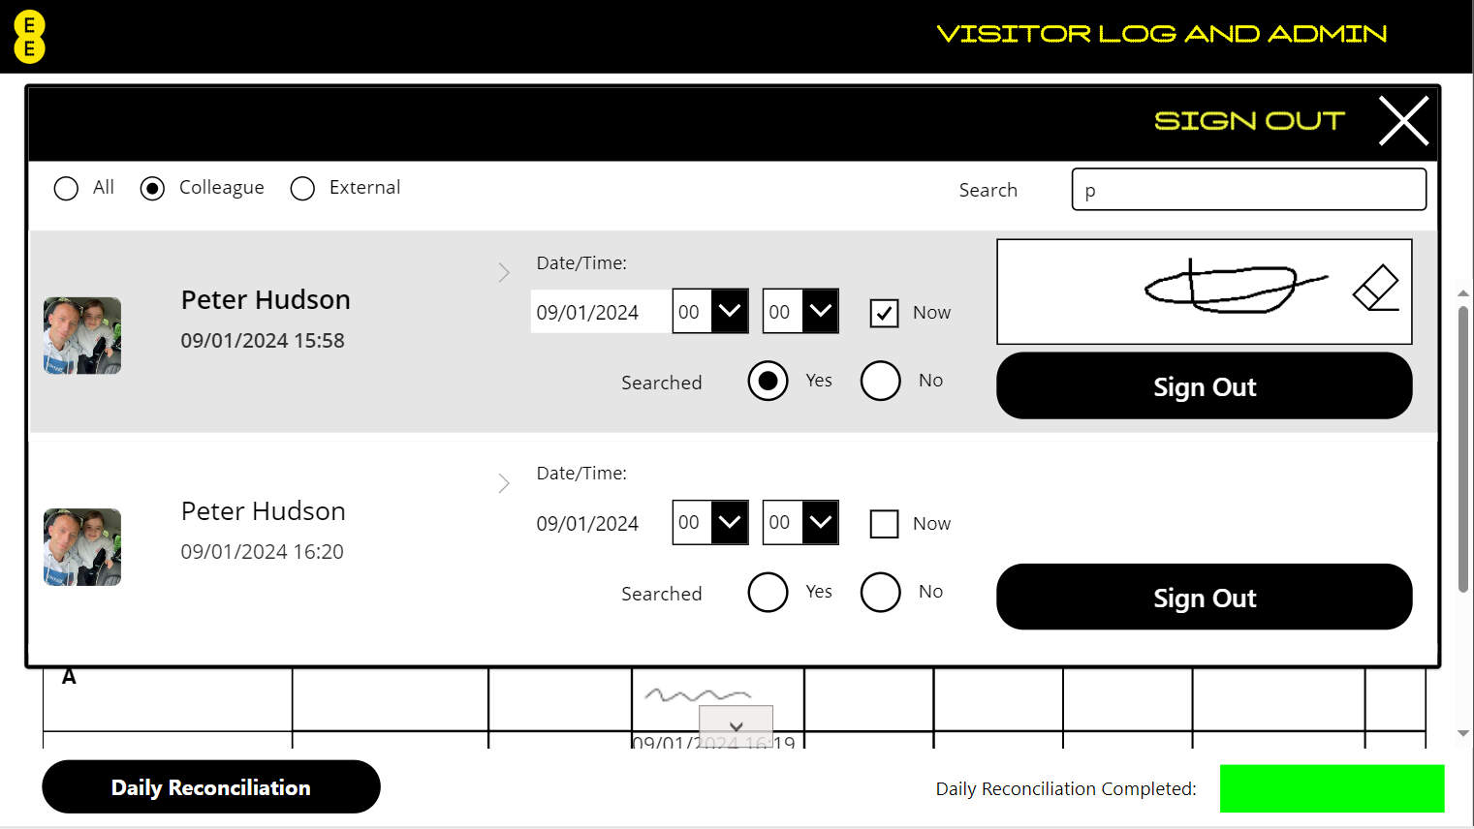
ADHOC SEARCH
‘Searched’ will be default as “Yes”
Select the team member to search, sign in the box and select ‘Searched’
(If you make a mistake don’t worry, just hit the erase icon)
Searched
Searched
Adhoc Search
The signature box will show if ‘Yes’ is selected to search
Remember that all visitors must be searched when leaving

Slide 24
VISITOR SIGN OUT AND SEARCH
Select ‘Sign Out’
Adhoc Search
Select ‘Sign Out’ to sign out visitors or to back date the sign out for a team member

Slide 25
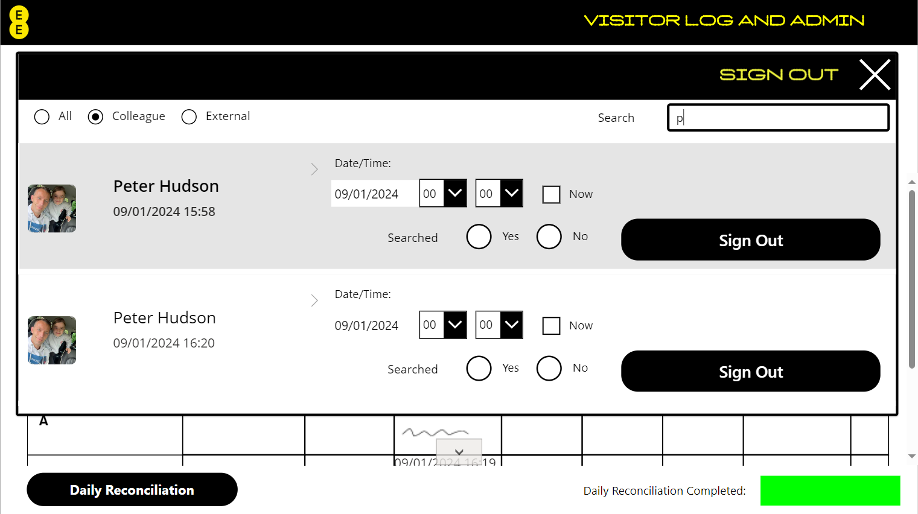
VISITOR SIGN OUT AND SEARCH
Either scroll or search by selecting ‘Colleagues’ or ‘External Visitors’ and start typing the name in the ‘Search’ box
If signing out after leaving, uncheck ‘Now’ and select the time of exit
Adhoc Search
The search box will only search once ‘Colleague’ or ‘External’ has been selected
Scroll through the visitor log or use the search box
Make sure that either ‘Now’ or an earlier time is selected when signing a visitor or team member out
Failing to do this will cause the incorrect time to be recorded

Slide 26
VISITOR SIGN OUT AND SEARCH
Select if completing a search
Sign in the box and select ‘Submit’
(If you make a mistake don’t worry, just hit the erase icon)
The signature box will show if ‘Yes’ is selected to search
Remember that all visitors must be searched when leaving

Slide 27
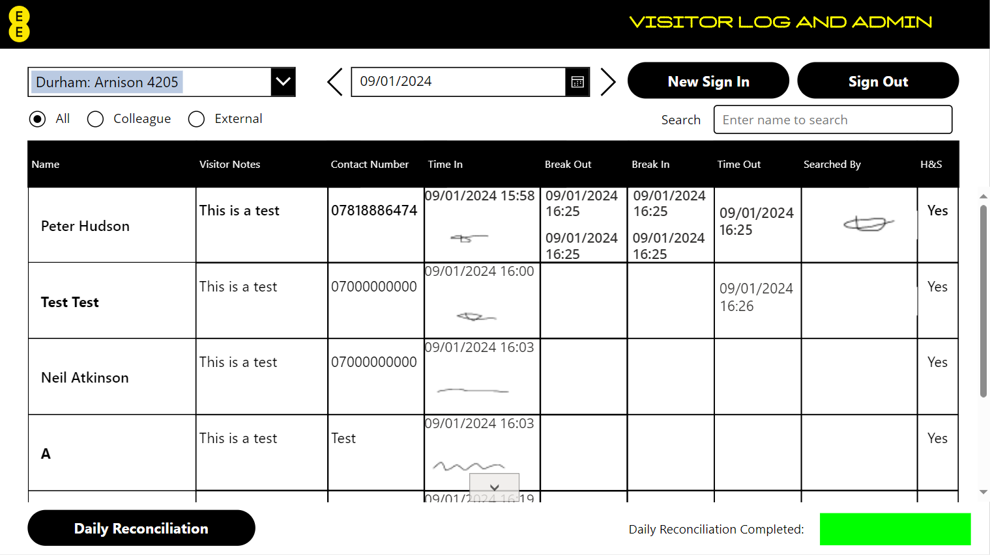
HOW IT LOOKS
The time out and signature are displayed on the log
Adhoc Search
All sign out details are displayed on the log including breaks, time out and search signatures
Please follow the search guidelines found in the ‘Sign In and Search’ policy

