Slide 1
THE MOBILE APP

Slide 2
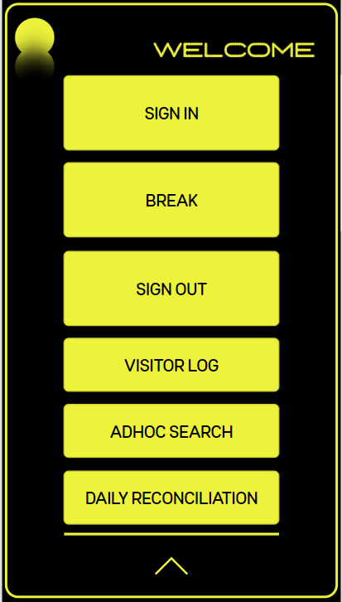
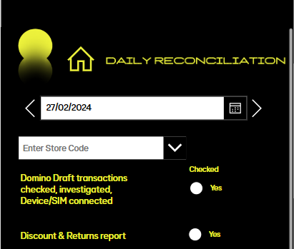
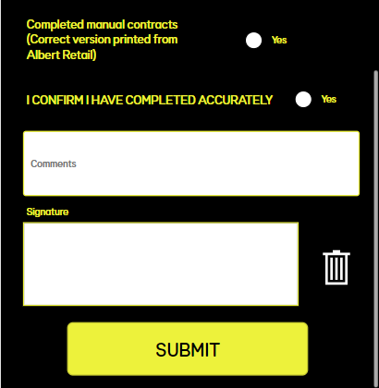
Daily Reconciliation
Enter your store code or name. Select the date you’re completing the reconciliation for.
Complete all the daily checks, enter any comments, sign to confirm that the daily reconciliation is completed and select ‘SUBMIT’.
‘COMPLETED’ will display once completed
To complete the daily reconciliation, open the app, select the down arrow to open the admin menu and select
‘DAILY RECONCILIATION’

Slide 3
THE TABLET APP

Slide 4
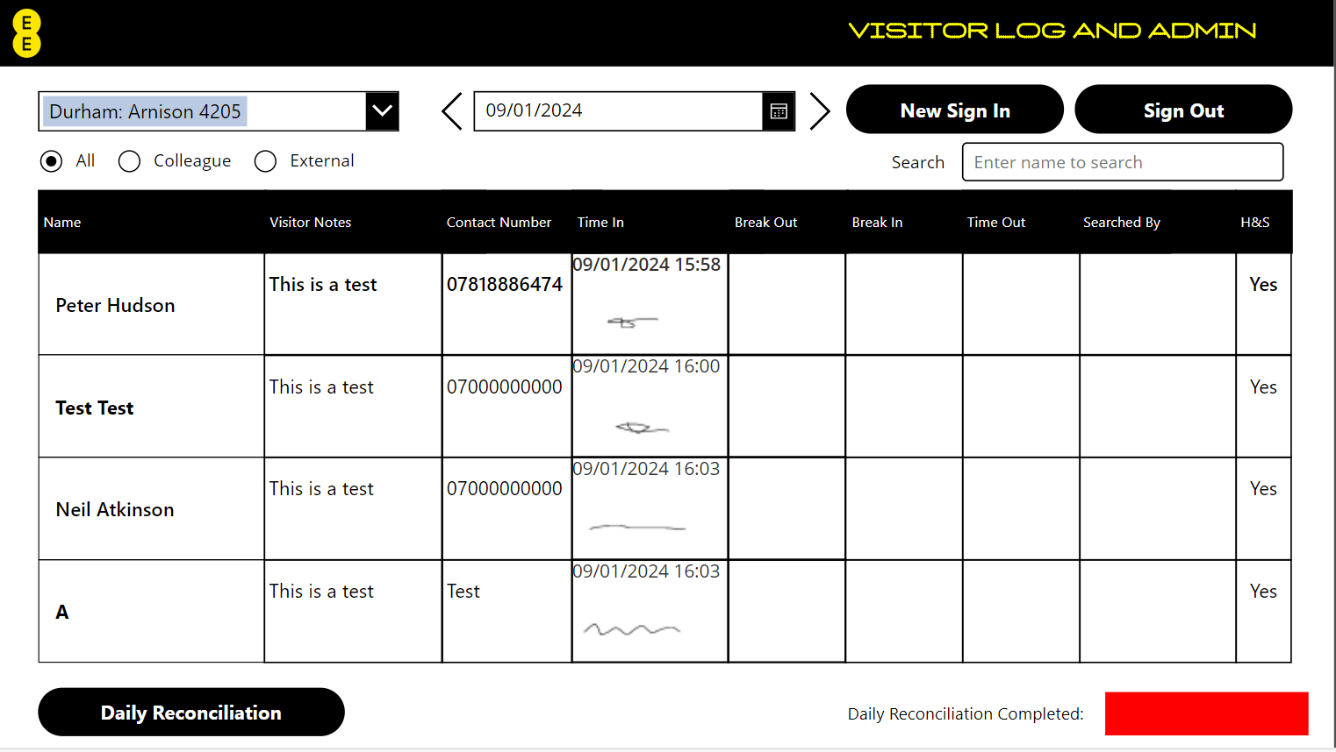
DAILY RECONCILIATION
Adhoc Search
Select ‘Daily Reconciliation’
Daily reconciliation must be completed daily
Please check the ‘Daily Admin and Paperwork’ policy for more details on completing the daily checks

Slide 5
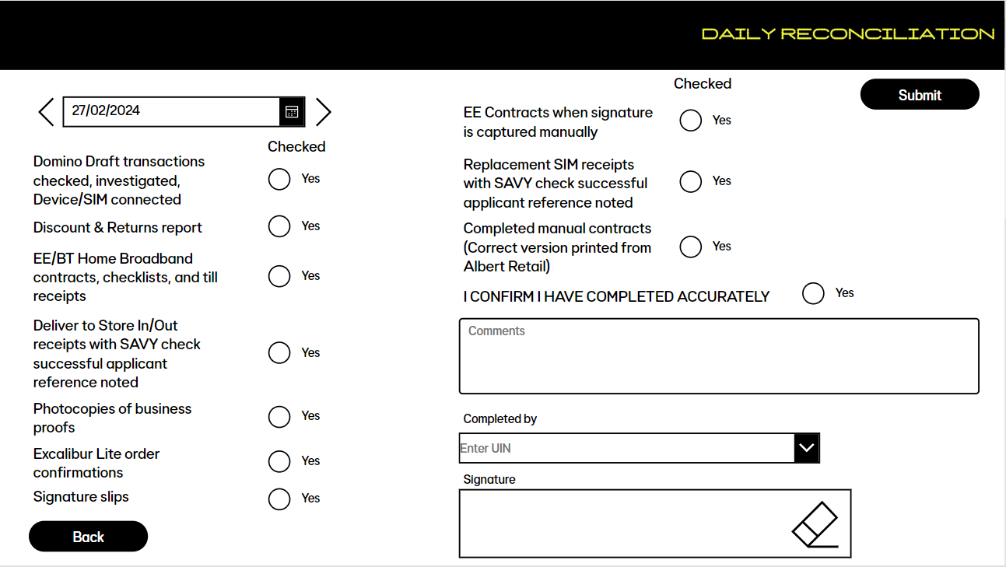
DAILY RECONCILIATION
Select the date that you are completing the reconciliation for, complete all the required checks for the previous day as ‘Yes’ or ‘NA’, enter your UIN and select, record any notes, sign in the signature box and select ‘Submit’
Complete all questions on the declaration
Please note:
Please check the ‘Daily Admin and Paperwork’ policy for which paperwork must be retained and filed, securely, in a brown envelope

