Slide 1
Compliance declaration store leader completion guide
& regional leader open actions q4 2024

Slide 2
Rules for completion
  This is a mandatory Store Leader task and should only be completed by your second in line in extreme circumstances, pre-agreed with your Compliance Manager. This must be confirmed by email.
  You have a three-week window to complete the Declaration fully. It is required that this time is used to:
  Download/print and use the Compliance Declaration Support Guide to enable you to accurately complete your checks.
  Answer all tests within each of the sections.
  Take the corrective action required and complete the Action Taken/To Be Taken section detailing what specific action you have taken to correct the issue. You must also state the date the action was/will be closed.
  You must detail what action you have taken rather than what you are going to do. All sections on Power Apps must be submitted before the deadline, fully completed with no actions outstanding.
  Should there be an exceptional circumstance where you have failed to complete/close the action, then you will be asked to record a close by date prior to submission. You must have a specific reason for not completing this task e.g. staff member on Maternity leave and needing to complete training on return.
  It is unacceptable to reach the end of the Declaration window with actions still outstanding unless you have specifically detailed why and added a ‘close by date’.
  Failure to complete this mandatory task honestly, accurately and within the deadline period may result in disciplinary action being taken.
  As this is a formal BT control all output may be subject to second line Audit review.

Slide 3
Preparing to complete your Compliance Declaration
STEP 1 | Download/ print the Compliance Declaration Support Guide, reading each question thoroughly to ensure you understand how to answer each test. Use this support guide to note your findings and actions before submitting on Power Apps.
STEP 2 | Work through a section at a time on your Support Guide. Once you have fully completed one section, recording any non-compliant findings and actions, access and complete each section on Power Apps.
STEP 3 | Ensure that any open actions have a close by date recorded. You will need to keep your Support Guide until all actions have been closed.
  The Compliance Declaration is now submitted using Power Apps and split into different sections. Plan ahead for the completion of your Declaration. Ensure you have enough staff scheduled in to provide sufficient cover.
  Ensure you submit all sections on Power Apps. You can submit these sections separately throughout the three-week window if you wish.
  Use your Support Guide to conduct your checks thoroughly before you submit on Power Apps as once submitted changes cannot be made. The Support Guide can be used as a notepad and once all actions are closed, you can shred it. However, if you have open actions, you will need to keep it until all exceptions have been corrected and actions closed.
  Record any known issues on your Declaration even if this exception is not identified from the sample checks.
  Your Regional Leader will check any open actions that you have declared. Failure to close all open tasks may result in disciplinary action being taken.

Slide 4
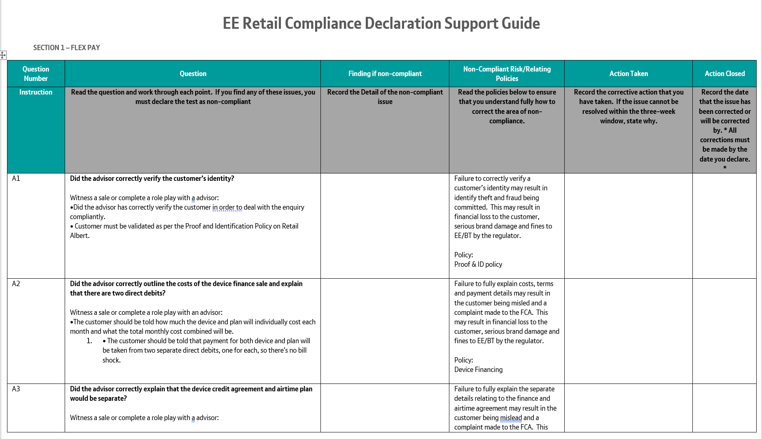
Completing the compliance declaration – the support guide
Download and print the Compliance Declaration Support Guide. Use this as a tool to support you when answering the questions as a draft to note your findings and actions.
You can print or save the document to draft your findings and actions prior to entering these into Power Apps for submission. The form is editable if you prefer to type.
Read each question carefully and follow the guide detailing exactly what to check for
The risks of being non-compliant are detailed here, along with the Policy to refer to for more information

Slide 5
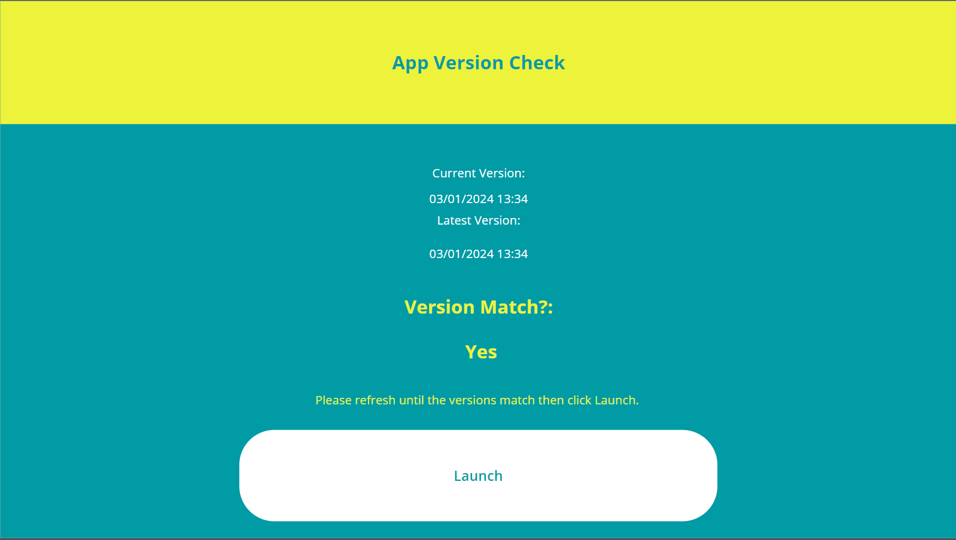
Completing the Compliance Declaration – Power apps submission
The Version Match must show as ‘Yes’ before you click launch. If it shows as ‘No’ keep refreshing until you see ‘Yes’.

Slide 6
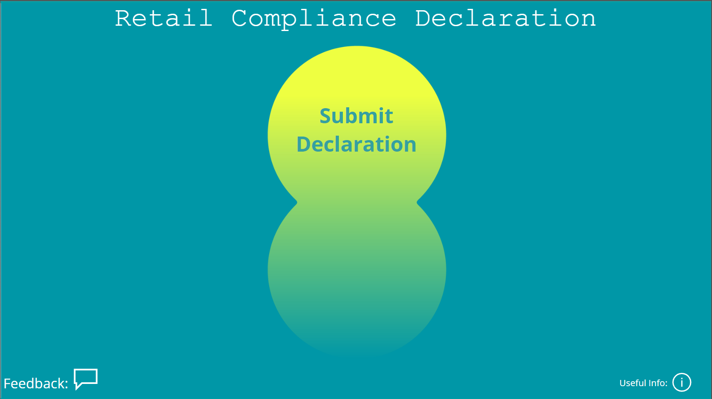
Completing the Compliance Declaration – Power apps submission
To begin your Compliance Declaration, select ‘Submit Declaration’.

Slide 7
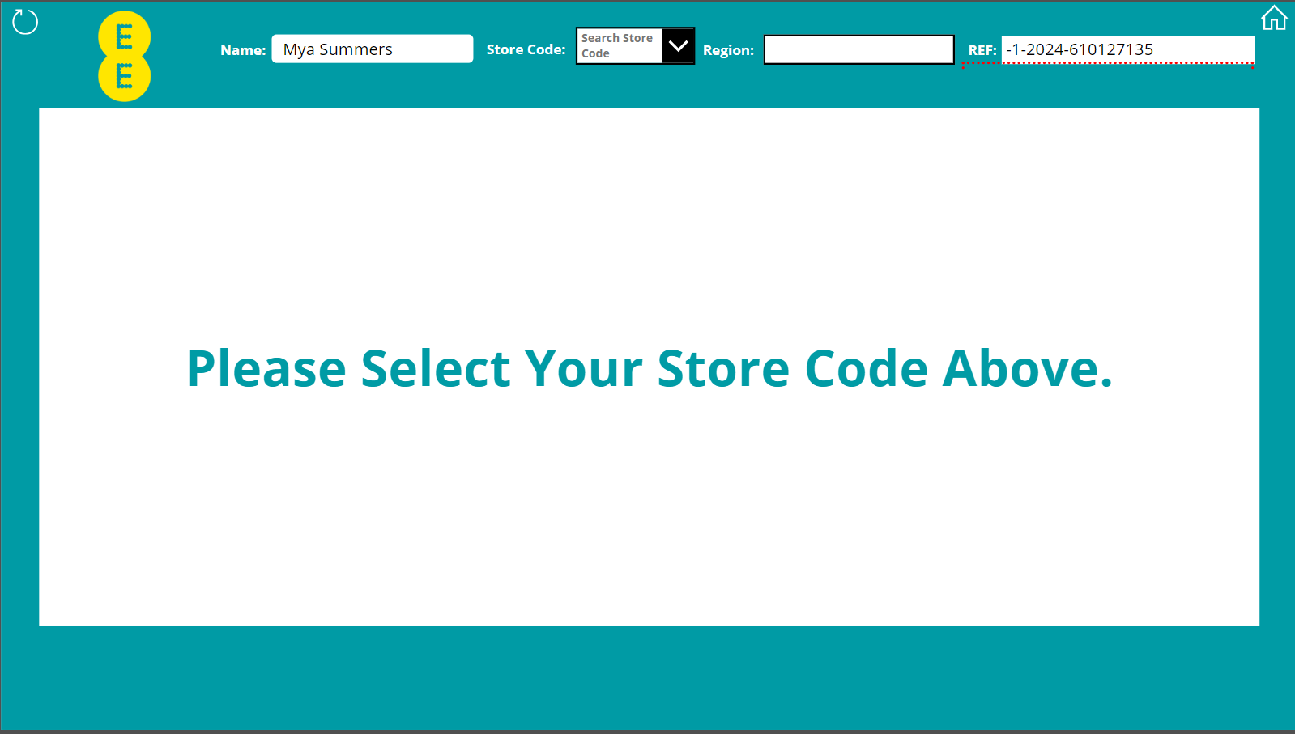
Completing the Compliance Declaration – Power apps submission
You must select the store code from the drop down list. If you enter the store code manually it will not allow you to continue.

Slide 8
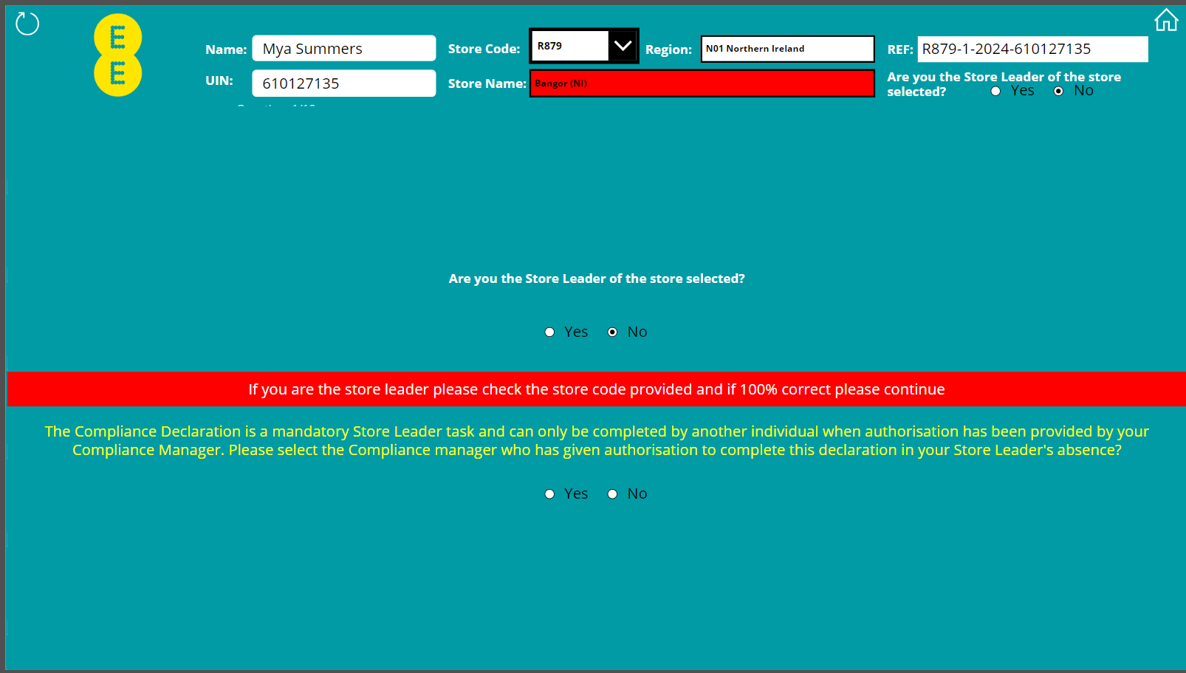
Completing the Compliance Declaration – Power apps submission
The Compliance Declaration can only be completed by the Store Leader unless in exceptional circumstance.
This must be authorised by email from your Compliance Manager.

Slide 9
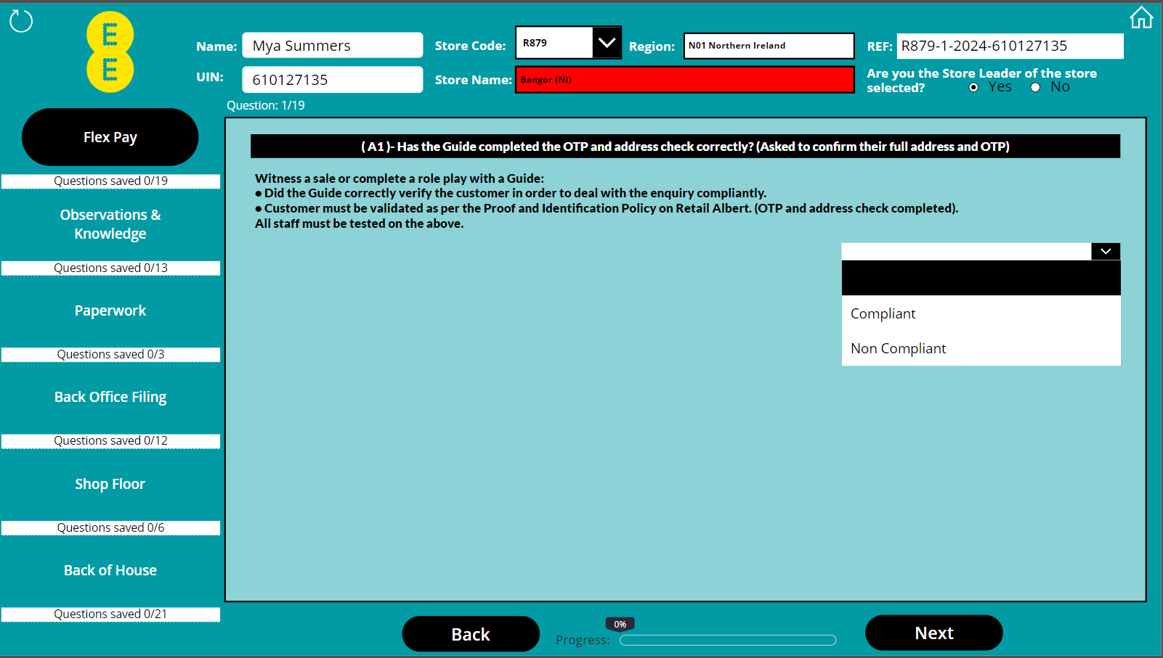
Completing the Compliance Declaration – Power apps submission
Each test must be answered as ‘Compliant’ or ‘Non Compliant’.
Once you have answered the test select Next to continue to the next test.

Slide 10
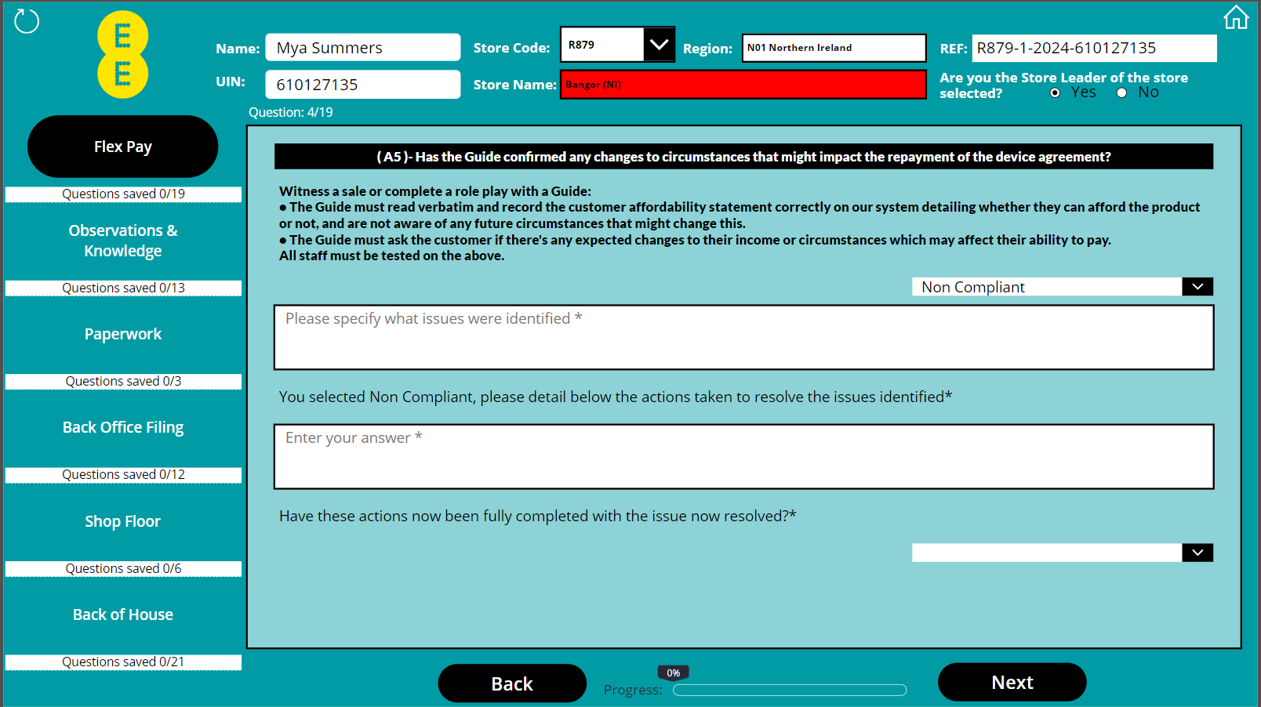
Completing the Compliance Declaration – Power apps submission
If you select ‘Non Compliant’ you must detail what issue was identified and detail the action taken to resolve the issue.

Slide 11
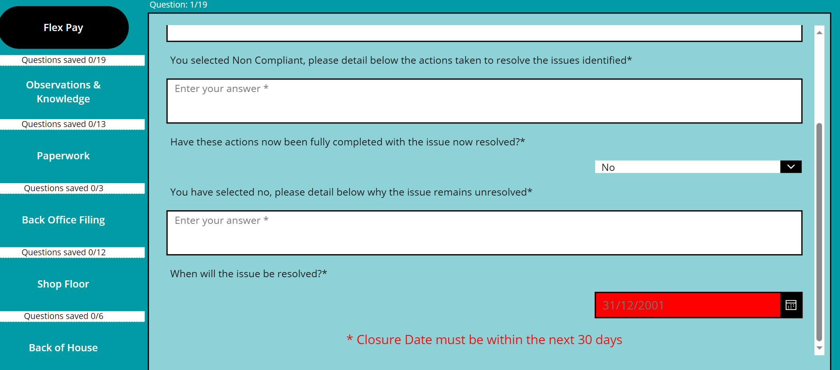
Completing the Compliance Declaration – Power apps submission
If the non compliant action has not been resolved during the window. You must select ‘No’ and give a detailed reason as to why.
The closure date must be within the next 30 days.

Slide 12
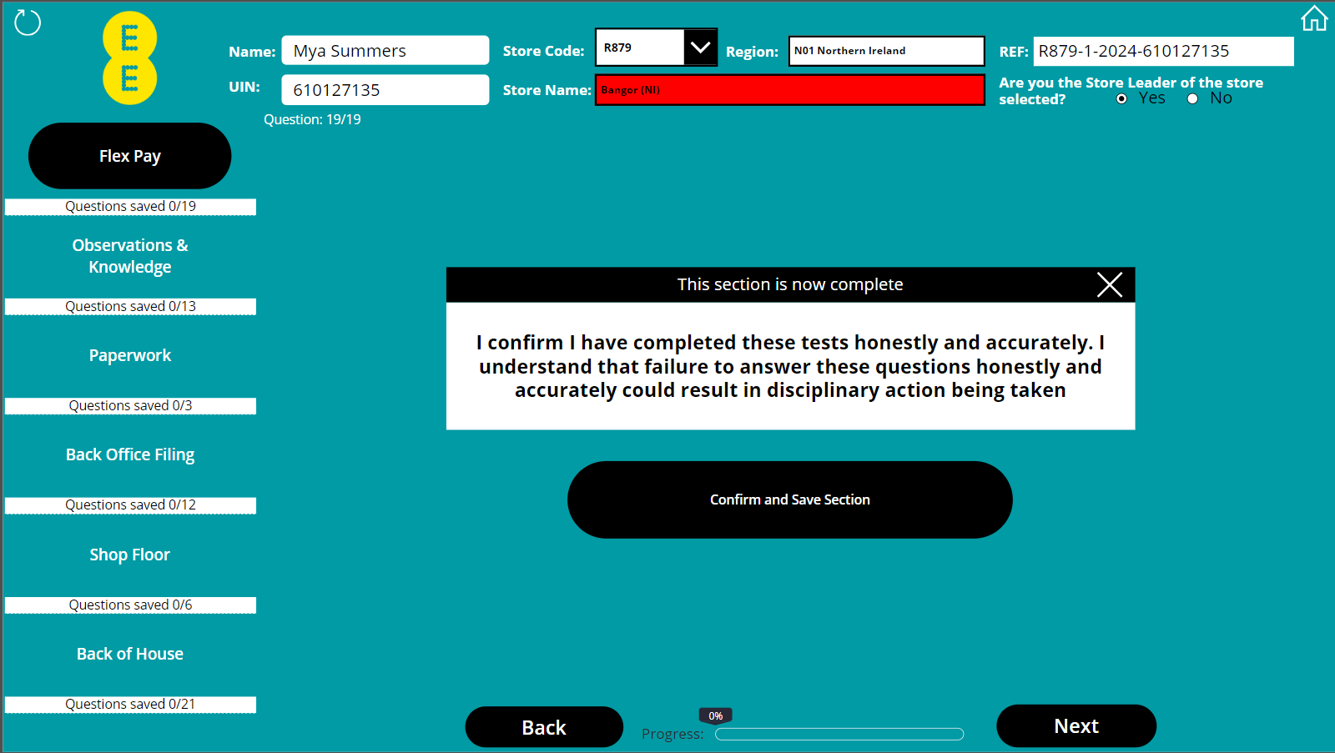
Completing the Compliance Declaration – Power apps submission
Once all actions in a section are completed this box will populate.
Once you press ‘Confirm and Save Section you will not be able to make any further changes.
It's important to note, that all tests in a section must be completed before you exit Power Apps. Any data entered which has not been confirmed as above will be deleted.

Slide 13
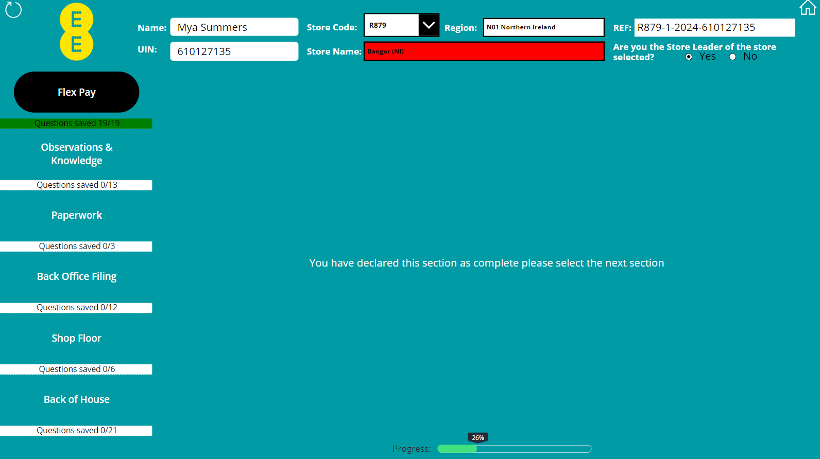
Completing the Compliance Declaration – Power apps submission
Once you have completed a section you will see both the section and the progress bar turn green.

Slide 14
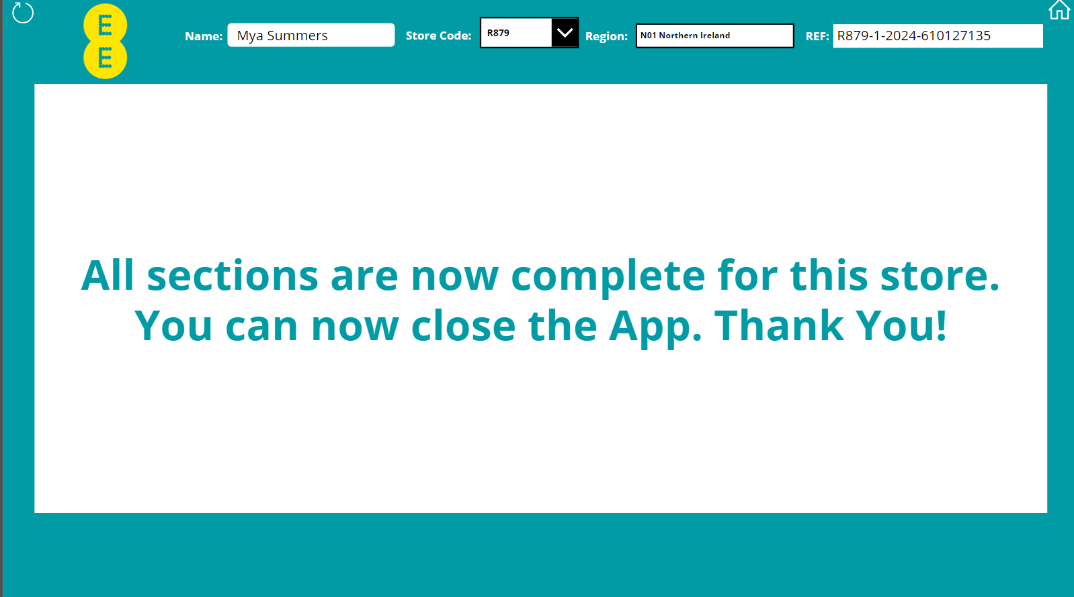
Completing the Compliance Declaration – Power apps submission
Once you see this message the Compliance Declaration is complete and the data has been saved. You can now close the App.

Slide 15
Next steps
Ensure you have a record of any incomplete/open actions. Retain your Compliance Declaration Support Guide until you are happy all actions are complete and work through these by the deadline stated on your submission.
If you are fully satisfied that all non-compliant exceptions have been fully corrected and closed, there is no requirement to retain the Compliance Declaration Support Guide and it can be shredded if no longer needed.
A list of your incomplete/open actions will be sent to your Regional Leader and this will be reviewed during their next visit.
Your Compliance Manager will also review your submitted Compliance Declaration and actions during your next Compliance Assessment and will ascertain how many outstanding or repeated actions have been witnessed during that assessment.
Compliance Declaration Review Assessments will take place on random stores each quarter to ensure all stores are completing this task honestly & accurately and that all actions have been corrected.
Remember, that the declaration you have made is a true assessment of the operational and regulatory controls in your store. Failure to complete this task honestly and accurately may result in disciplinary action being taken.

Slide 16
regional leader open actions guide q4 2024

Slide 17
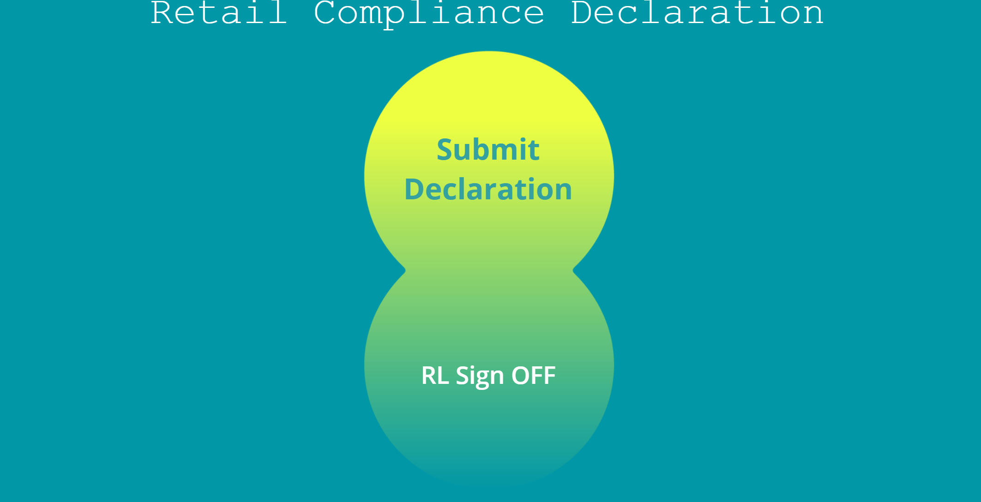
Closing the open actions – regional leader
Once you have received and reviewed the open actions report you can now start to close them down.
To begin click ‘RL Sign OFF’

Slide 18
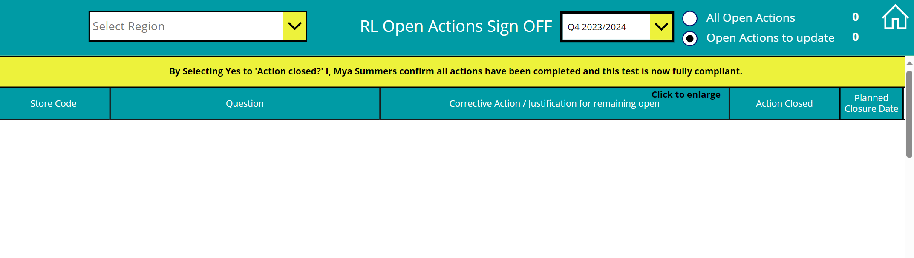
Closing the open actions – regional leader
Select your Region and confirm the Compliance Declaration Quarter.

Slide 19
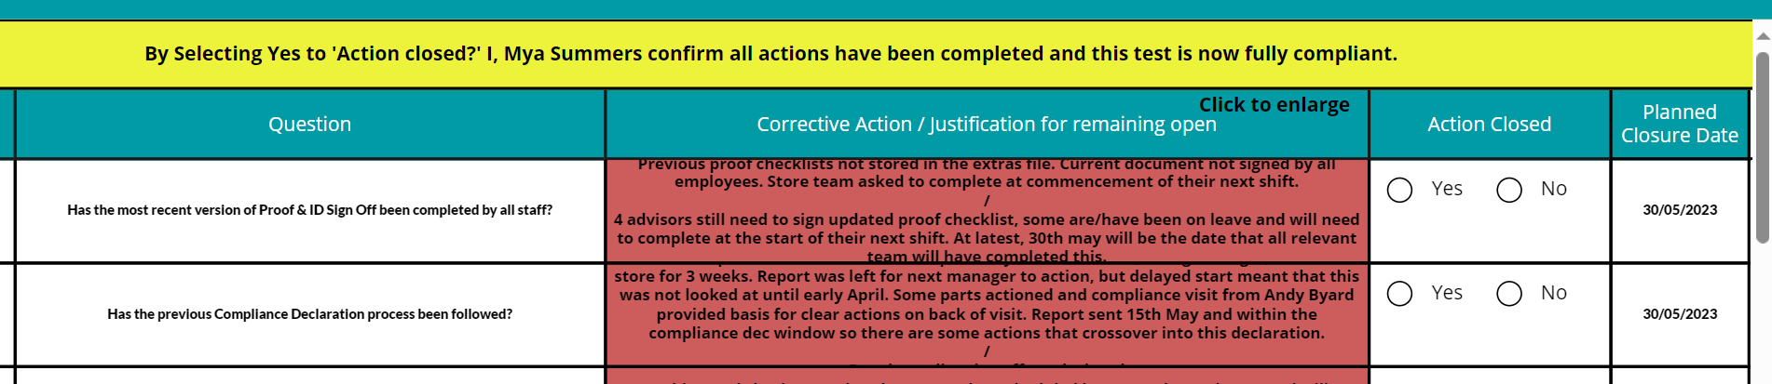
Closing the open actions – regional leader
Once you are confident the issue has been resolved, click ‘Yes’ and this will close the action. You will then see it disappear from the open actions list.

Slide 20
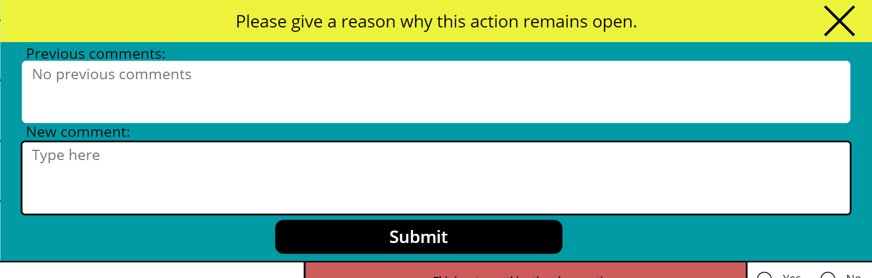
Closing the open actions – regional leader
If an action is still outstanding and needs to remain open, please select ‘No’.
This will then ask you to comment as to why the action has not yet been closed.
Once all Actions for your Region have been closed then the Compliance Declaration is complete.

