Slide 1
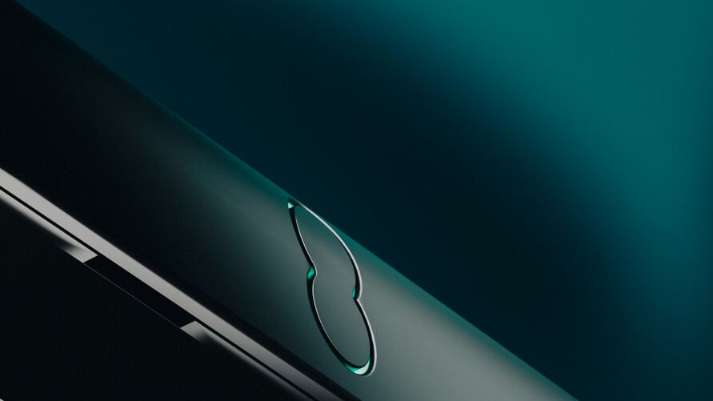

Broadband Buyout
STORE Briefing Pack

Slide 2
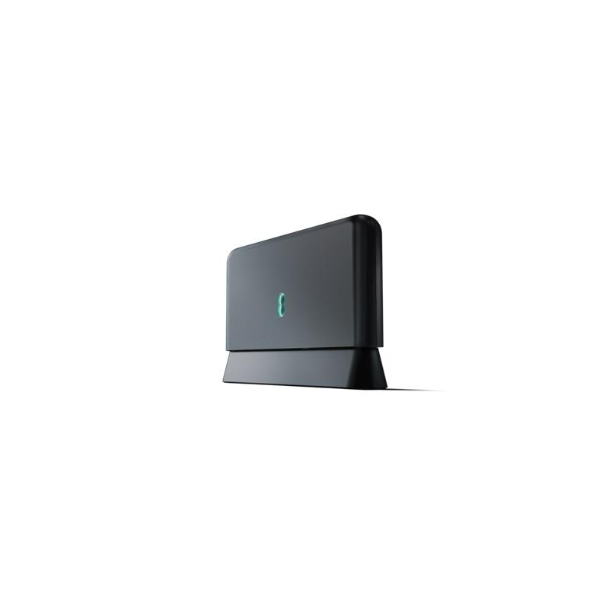
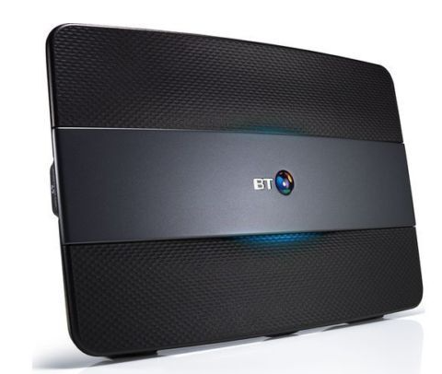
Retail Broadband Buyout
Last year we launched New EE to the country and unveiled New EE Home Broadband for all our customers.
We’ve had a brilliant start to the campaign, and we’ve listened to your feedback around giving you a tool to keep that momentum going - Retail broadband buyout!
Yes, you’ve read that right, you’ve asked for this and we've listened. Retail Broadband Buyout will be available from 8th January for new customers taking either New EE broadband or BT Broadband.
Check out the pack on the detail, process and business rules

Slide 3
What are we introducing?
Broadband buyout will be available for both NEW EE and BT customers.
The process for New EE will be integrated as part of the current Orbit journey for broadband. There will be a new ‘Buyout’ tick box which needs selecting. This will send the customer all the info to fulfil the offer.
For BT customers, the process is in Advisor hub. There is a new template message for buyout that would need to be sent to the customer, which will support the customer in the fulfilment process.
WHEN?
Buyout will be available from 8th January ‘24
WHO?
Buyout can be offered to any customer that is currently under a broadband contract with a competitor* taking a new ADSL or Fibre product.
*Buyout will not be available for existing BT group customers, so please do not offer this to EE/Plusnet/BT customers.

Slide 4
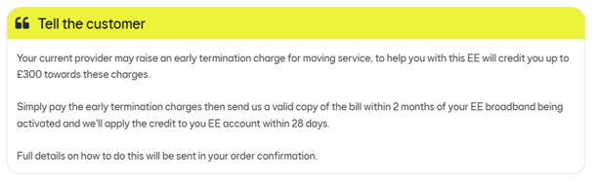
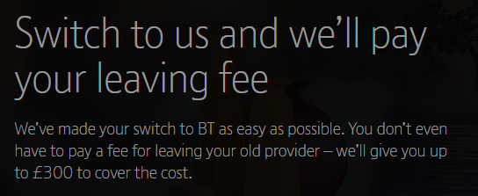
What do customers get?
NEW EE
The buyout gives the customer an opportunity to claim up-to £300 to help to pay off their final bill with their current provider (this will not include line rental, TV, call packages etc.)
The customer simply pays off their existing bill and sends us an itemised bill of the final payment, then we credit their account to the amount of their final bill.
BT

Slide 5
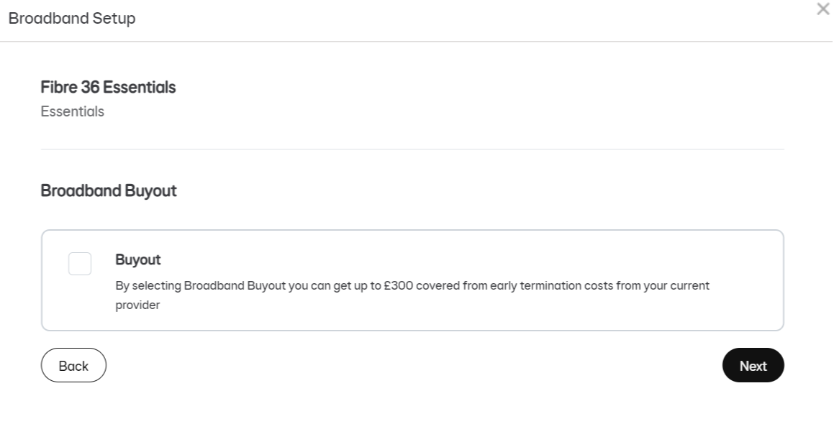
What does the New EE process look like?
1
Select the tick box for buyout as of the normal Orbit journey. That’s it!

Slide 6
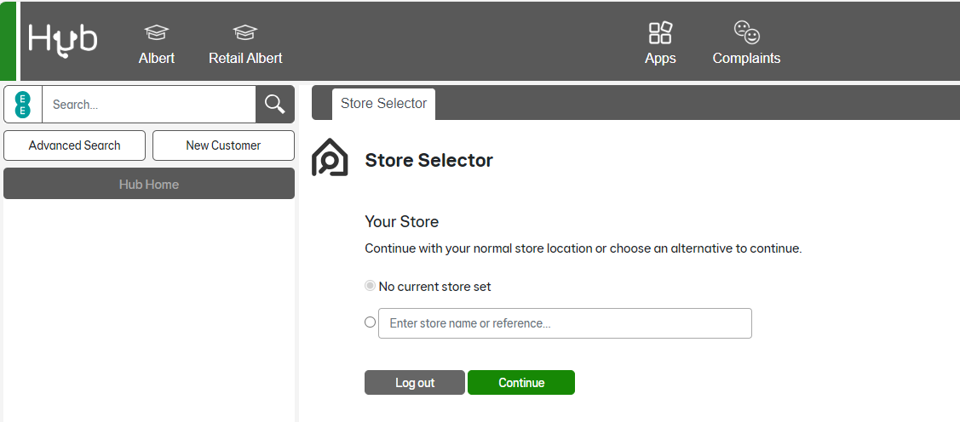
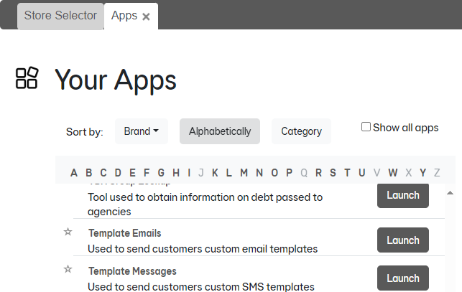
What does the BT process look like?
1
First open Advisor Hub and click ‘Apps’
2
Then search for ‘Template Messages’ and click ‘Launch’

Slide 7
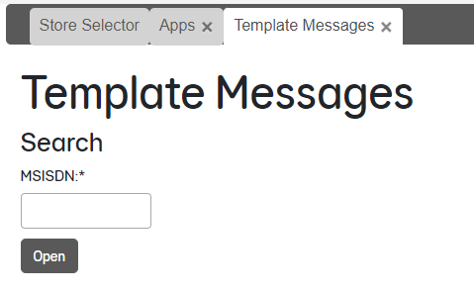
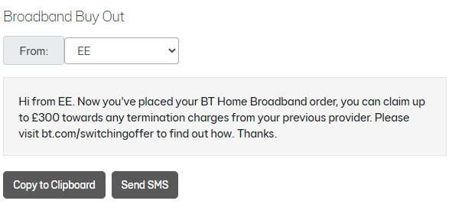
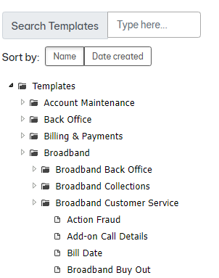
What does the BT process look like?
3
Once loaded, please enter the CTN
4
Then choose ‘Templates’ ‘Broadband’
‘Broadband Customer Service’
‘Broadband Buy Out’
5
Then click ‘Send SMS’

Slide 8
FAQ’s
Who can't have it?
Customers with Business Broadband
Customers with legacy EE broadband (Sales Plus)
Customers with BT Broadband (moving to New EE broadband)
Customers ineligible to take New EE Broadband
BT Group employees
New EE employees
4G or mobile broadband customers
A few things to remember:
The New EE account name must be in the same name as their previous broadband provider to be eligible to claim the credit.
Credits are applied to their New EE/BT account within 28 days of us receiving a valid copy of the final bill from their previous provider, with early termination fees clearly shown. Once applied the credit will be shown on the customer's next bill
There is no cash alternative to this offer.
The customer must pay the bill from the previous provider, we do not pay this for them.

Slide 9
FAQ’s
What does the broadband buyout cover?
The buyout will only cover the cost of the customers buyout for their home broadband (this will not include line rental, TV, call packages etc.)
Who is this available to?
Buyout will be available from all providers (not including for existing BT group customers, so please do not offer this to EE/Plusnet/BT customers) taking a new ADSL or Fibre product on either New EE or BT.
What does the customer need to provide to claim?
The buyout will only be honoured if customers provide an itemised final bill from their current supplier
What do I do if I forgot to tick the button in Orbit?
Please direct your customer to the following website, ee.co.uk/switching-offer
What happens if my customer doesn’t have a mobile number and wants to take BT home broadband and the buyout offer?
Let your customer know they can redeem this offer by visiting bt.com/switchingoffer
How long does it take for the buyout to be credited to the customer?
Credits will be applied within 28 days of submitting their final bill with an itemised early termination charge
How long does the customer have to make a claim?
The customer can request a buyout within 2 months of their home broadband activation date

