Slide 1


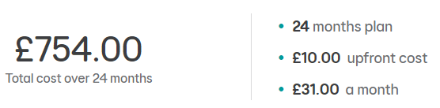
Features
Bundle Exclusive to EE
Enjoy the PlayStation®5 Console – God of War™ Ragnarök Bundle.
24 months of PS Plus Premium (4 X £50 PlayStation Store gift cards – worth £199.98)
Includes Gamer’s Data Pass – on Mobile Number (worth £11 per month)
Includes Video Pass – on Mobile Number (worth £12.49 per month)

Slide 2



Enjoy hundreds of PS5, PS4 and classic PlayStation games, and unmissable benefits from the premium membership plan that unleash the power of your PlayStation console.
A Whole 24 Months Included!!

Slide 3



Slide 4



Slide 5

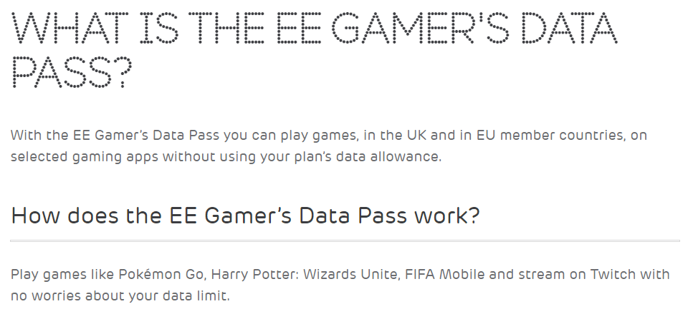

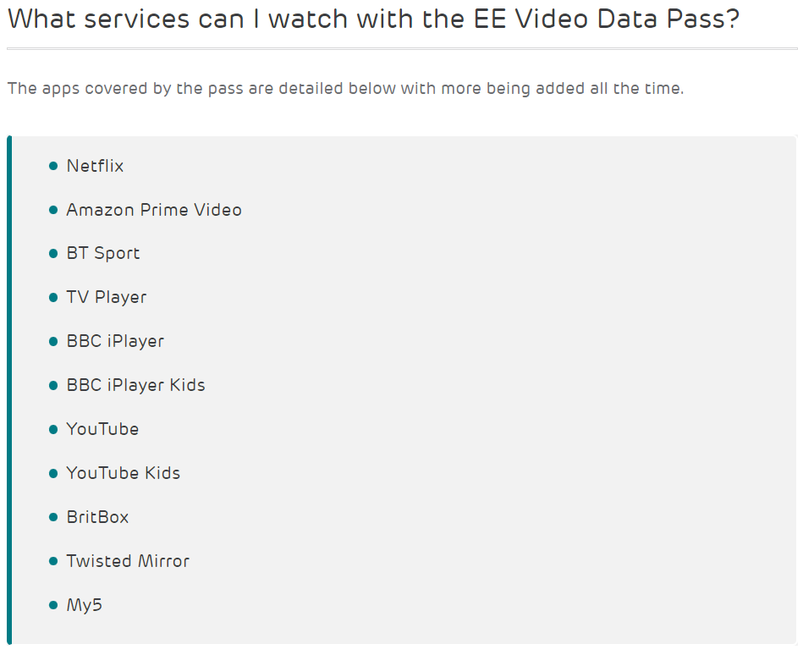


Slide 6

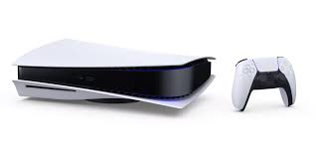
The PS5 console unleashes new gaming possibilities that you never anticipated. Experience lightning fast loading with an ultra-high speed SSD, deeper immersion with support for haptic feedback, adaptive triggers, and 3D Audio, and an all-new generation of incredible PlayStation games. The console is "Limited to One Per Customer".
Ultra-High Speed SSD. Maximize your play sessions with near instant load times for installed PS5 games.
Integrated I/O The custom integration of the PS5 console's systems lets creators pull data from the SSD so quickly that they can design games in ways never before possible.
Ray Tracing: Immerse yourself in worlds with a new level of realism as rays of light are individually simulated, creating true-to-life shadows and reflections in supported PS5 games.
4K-TV Gaming: Play your favorite PS5 games on your stunning 4K TV.
Up to 120fps with 120Hz output: Enjoy smooth and fluid high frame rate gameplay at up to 120fps for compatible games, with support for 120Hz output on 4K displays.
HDR Technology with an HDR TV: supported PS5 games display an unbelievably vibrant and lifelike range of colours.
8K Output: PS5 consoles support 8K Output, so you can play games on your 4320p resolution display.
Tempest 3D Audio Tech: Immerse yourself in soundscapes where it feels as if the sound comes from every direction. Through your headphones or TV speakers your surroundings truly come alive with Tempest 3D AudioTech in supported games.
Haptic Feedback: Experience haptic feedback via the DualSense wireless controller in select PS5 titles and feel the effects and impact of your in-game actions through dynamic sensory feedback. Adaptive Triggers: Get to grips with immersive adaptive triggers, featuring dynamic resistance levels which simulate the physical impact of in-game activities in select PS5 games.
PlayStation 5 Disc Edition

Slide 7
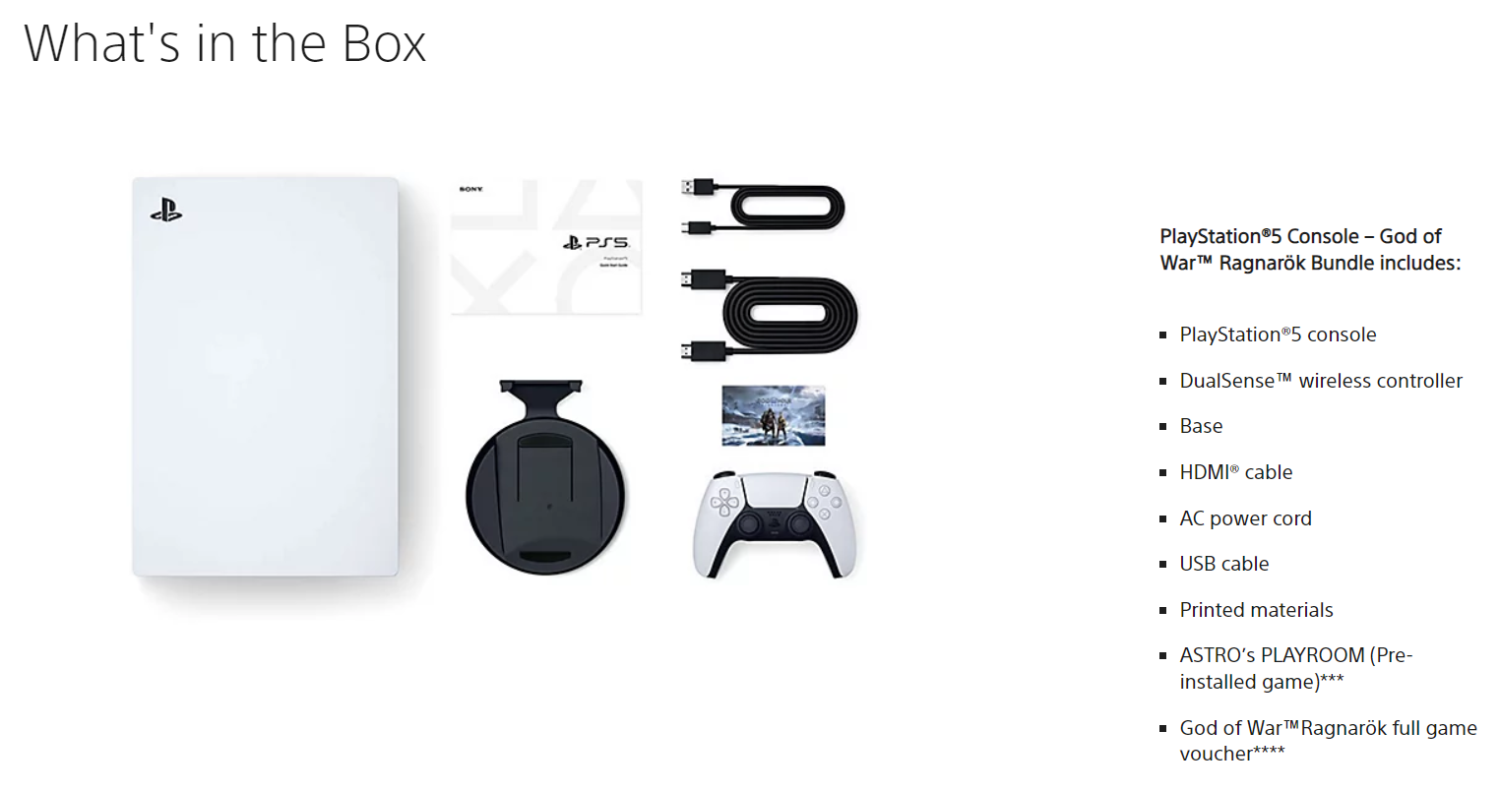


Slide 8

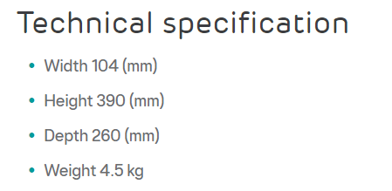


Slide 9

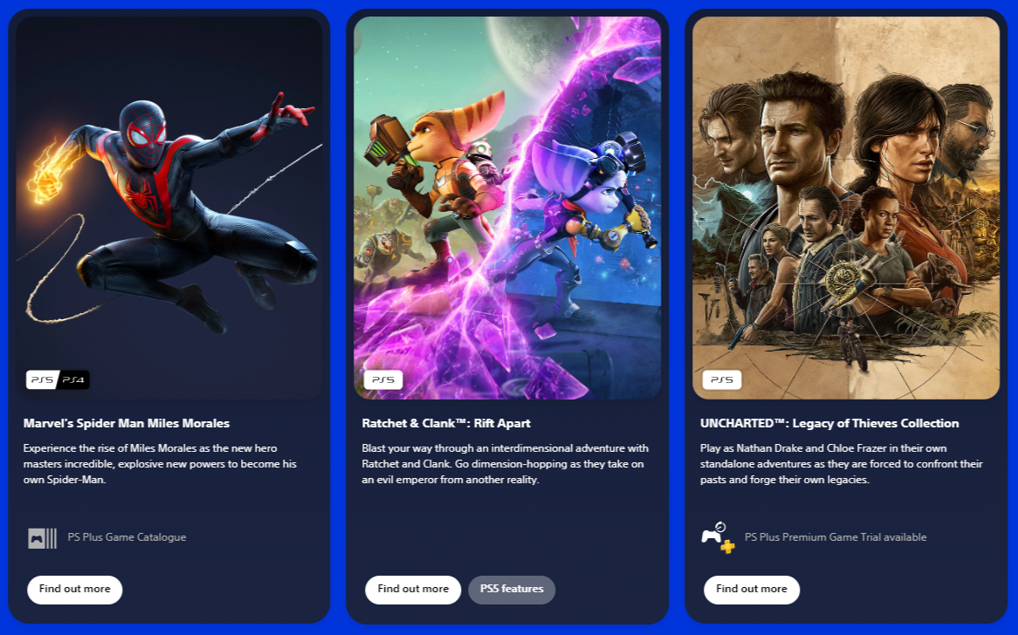
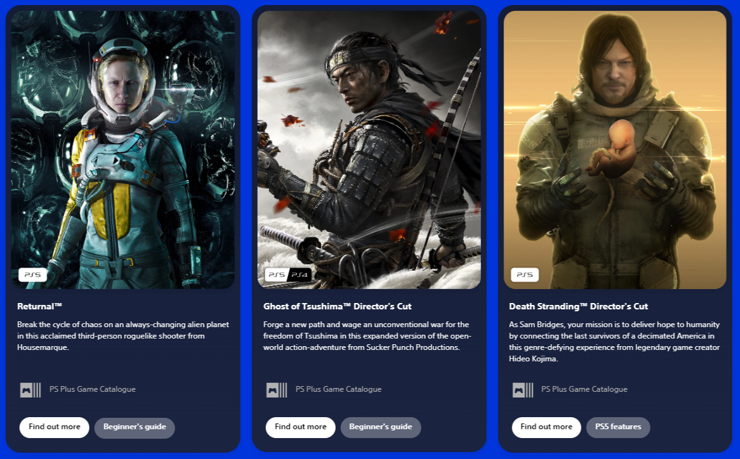
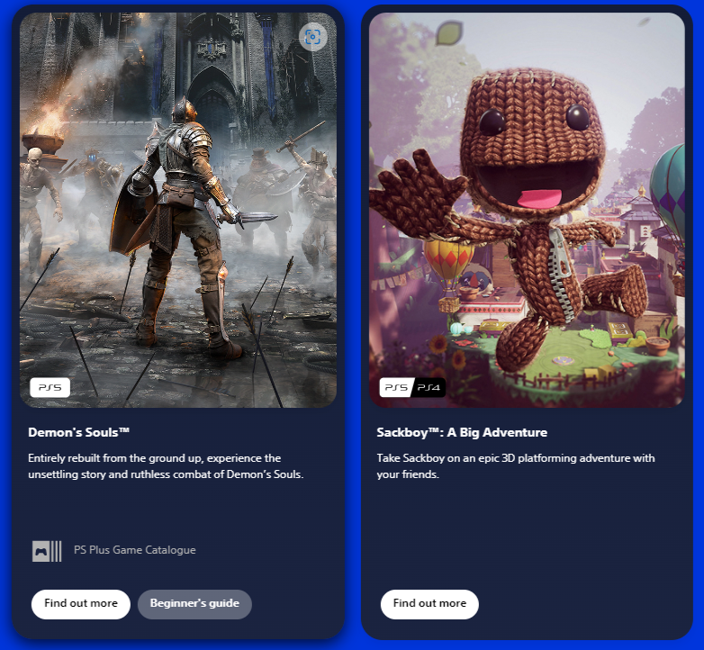

Top PS5 Games 2023

