Slide 1
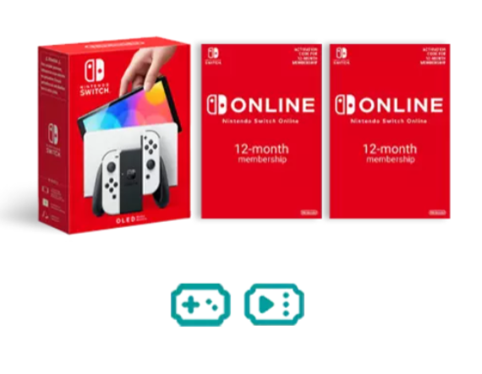
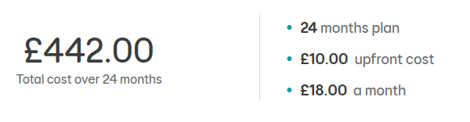

Features
Bundle Exclusive to EE (New White Colour)
7-inch OLED screen with slim bezels
2 X 12-month Nintendo Online vouchers for the redemption of 24 months Nintendo Online subscription (worth £35.98)
Includes Gamer’s Data Pass – on Mobile Number (worth £11 per month)
Includes Video Pass – on Mobile Number (worth £12.49 per month)

Slide 2






Enjoy a range of benefits including online play in supported Nintendo Switch titles, access to a growing library of over 100 NES, Super NES and Game Boy games, exclusive offers and much more!
For a Whole 24 Months Included!!

Slide 3

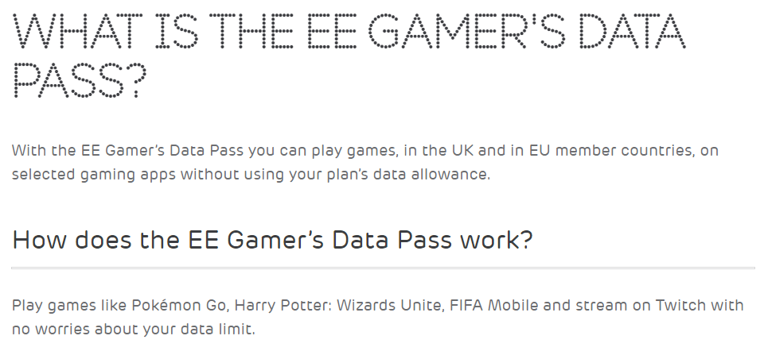
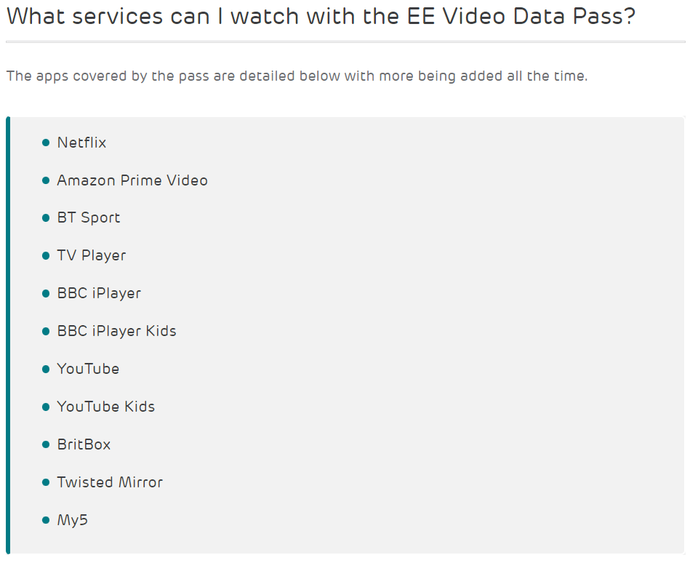
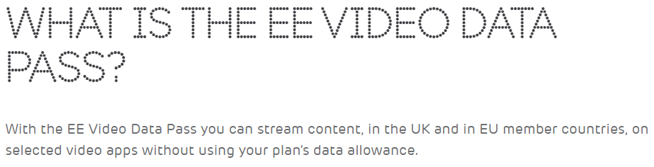

Slide 4

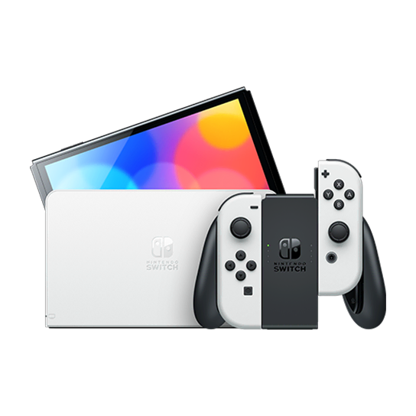
Meet the newest member of the Nintendo Switch family. The new system features a vibrant 7-inch OLED screen, a wide adjustable stand, a dock with a wired LAN port, 64 GB of internal storage, and enhanced audio. Play anytime, anywhere, with anyone. Nintendo Switch can transform to suit your situation, so you can play the games you want, no matter how busy life may be.
Pick it up and play with the Joy-Con controllers attached. Nintendo Switch (OLED model) includes an OLED screen with a slimmer bezel. The large screen's vivid colours and high contrast deliver a rich handheld and tabletop gaming experience, bringing games to life whether you're racing at top speed or squaring off against enemies.
Flip out the stand and hand a controller to another player to share the screen and enjoy competitive or co-operative multiplayer, anytime and anywhere. Nintendo Switch (OLED model)'s wide adjustable stand can be set to your preferred viewing angle for comfortable gameplay in tabletop mode.
Gather around a big screen and enjoy gaming with a crowd. Dock your Nintendo Switch to enjoy HD gaming on your TV. The dock included with Nintendo Switch (OLED model) features two USB ports, an HDMI port for connecting to a TV, and a new wired LAN port, allowing for more stable online play when playing in TV mode.
Save games to your system with 64 GB of internal storage & enjoy enhanced audio from the system's onboard speakers.
Approximately 4.5 - 9 hours. The battery life will depend on the games you play. For instance, the battery will last approximately 5.5 hours for The Legend of Zelda: Breath of the Wild. 3 hours when charging while the hardware is in sleep mode.
Charging time 3 hours and battery life is up to 5.5 hours when fully charged.
New OLED Nintendo Switch

Slide 5
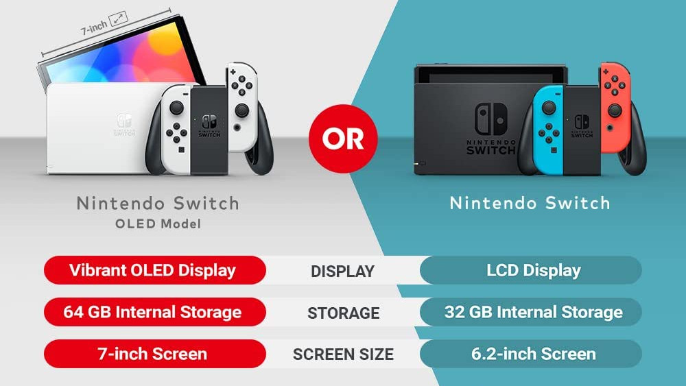
VS

Slide 6
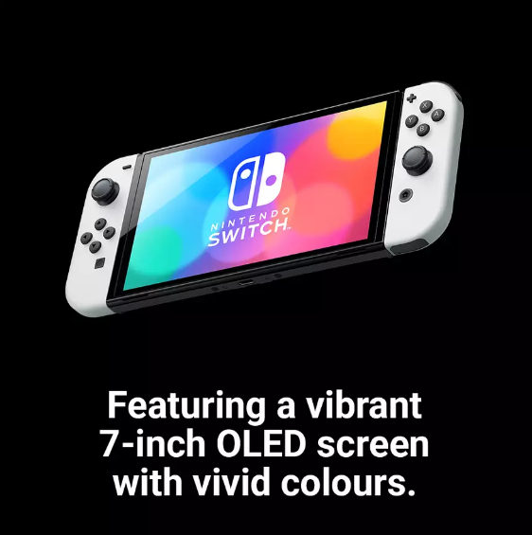
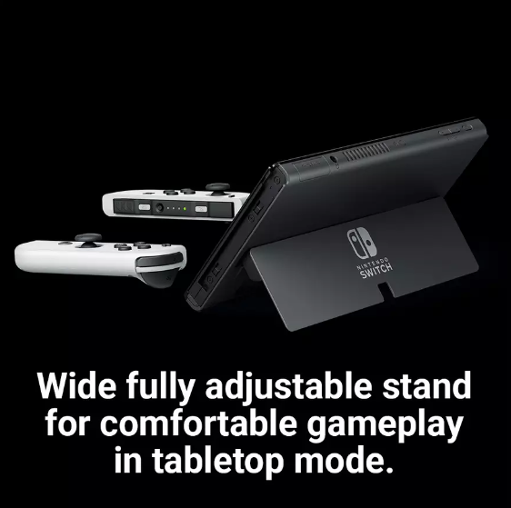
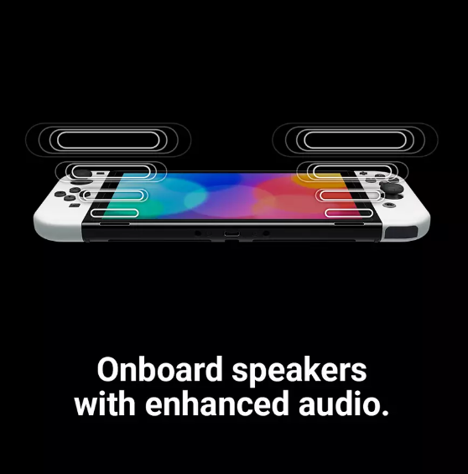
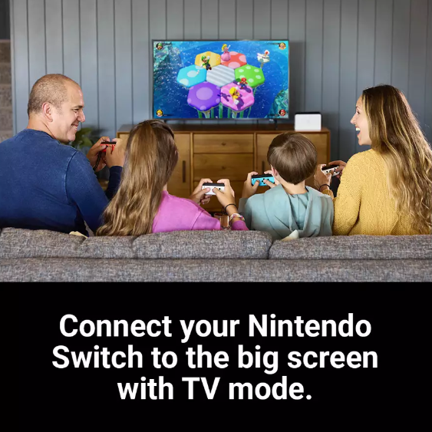

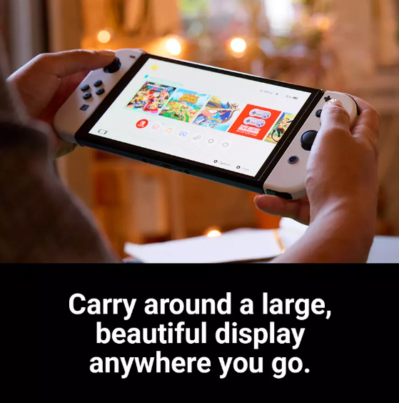

Slide 7
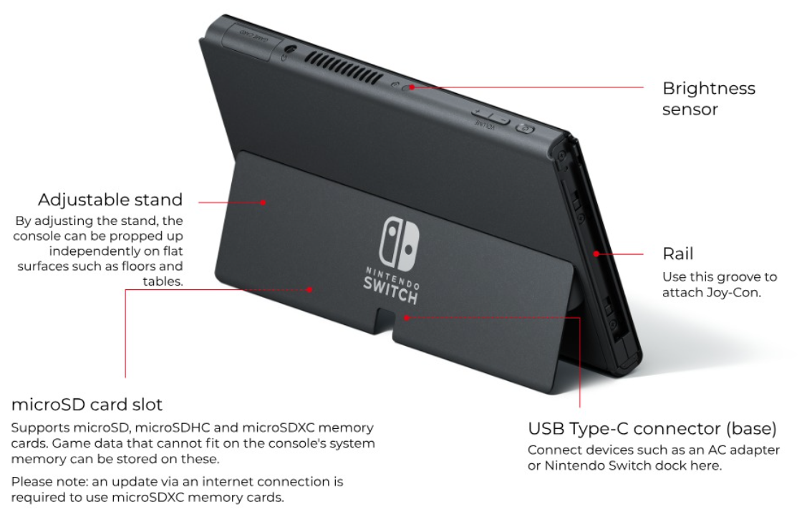
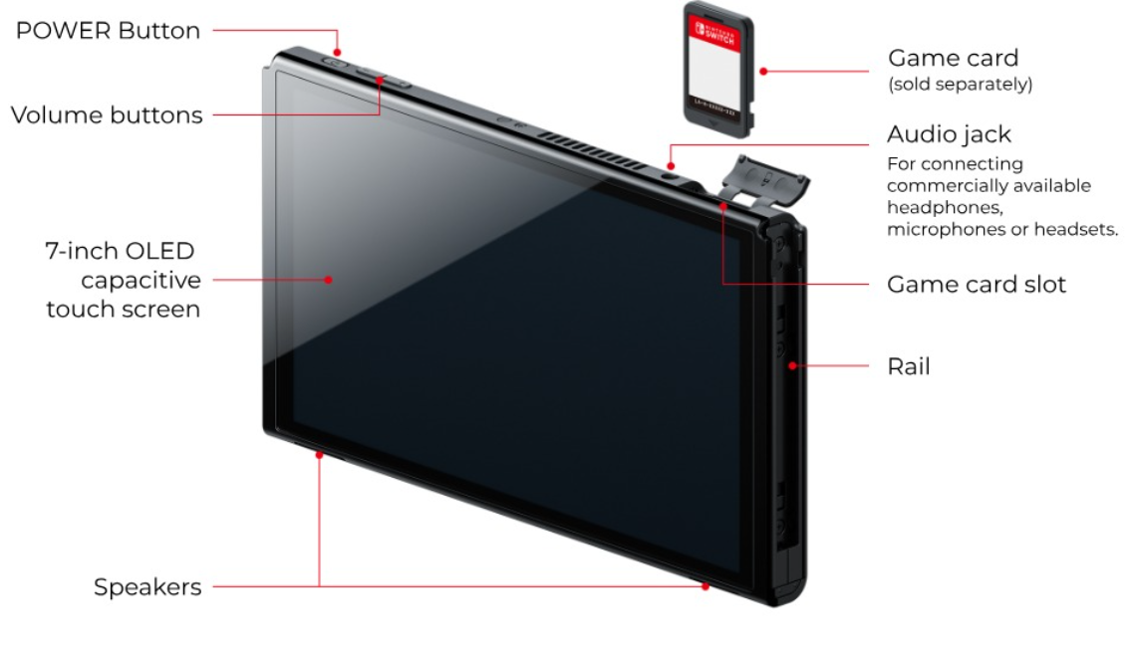
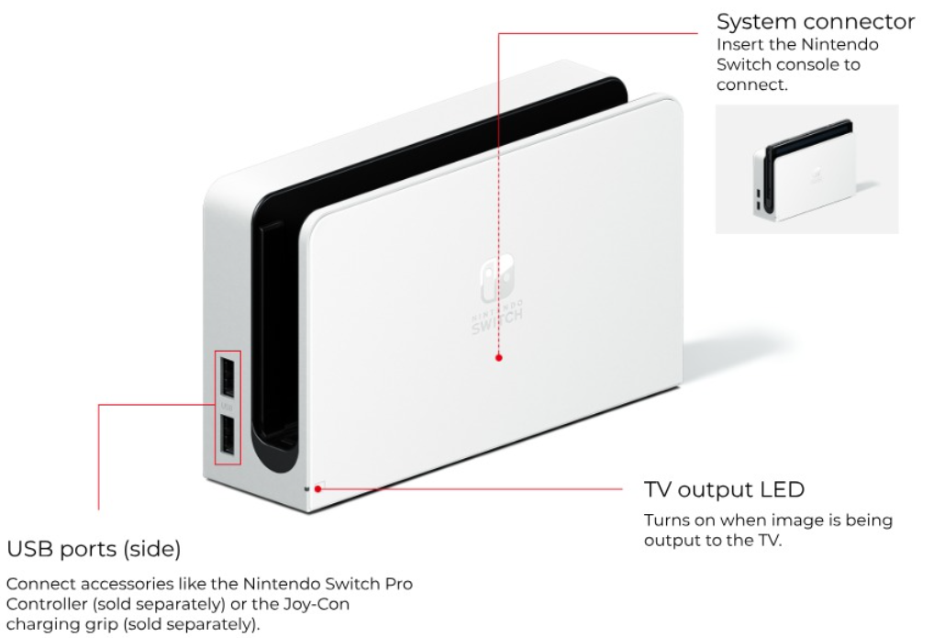
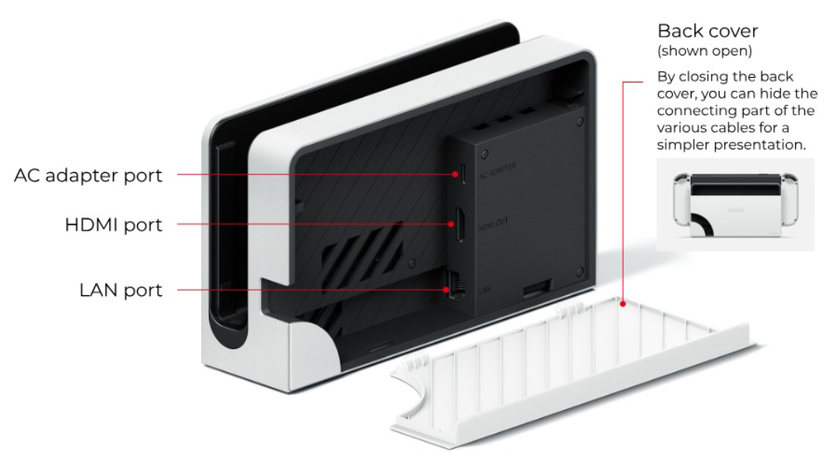

Slide 8
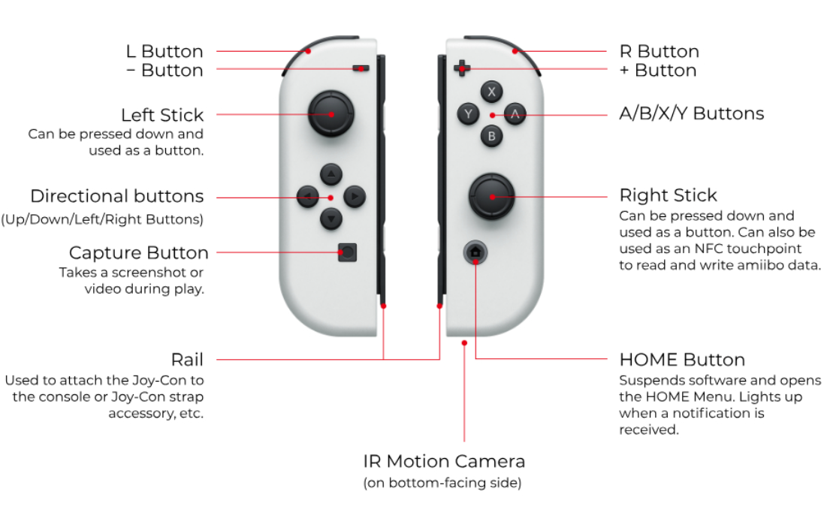
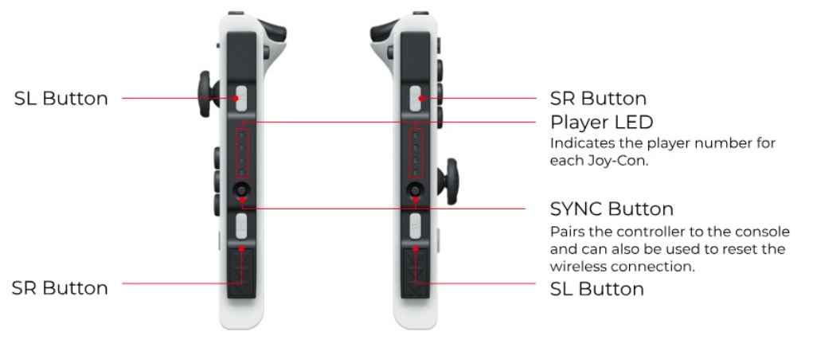
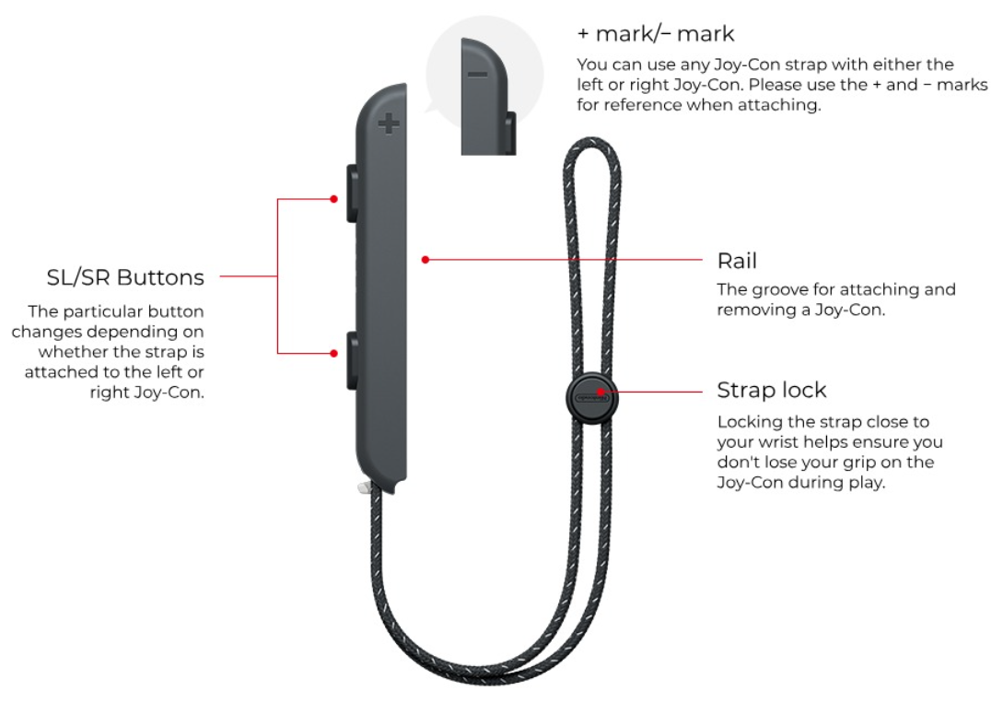
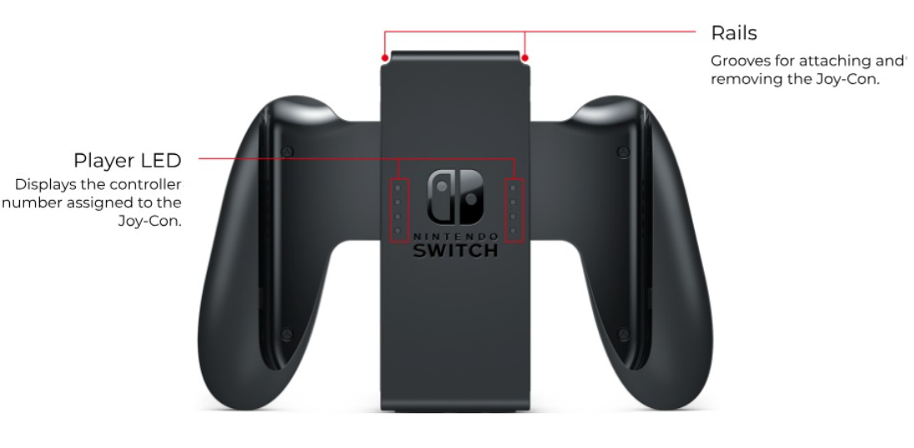

Slide 9
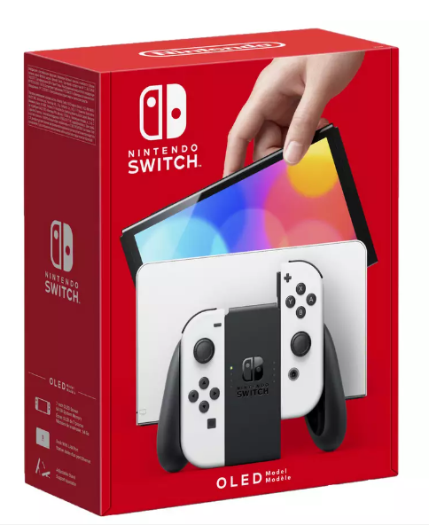
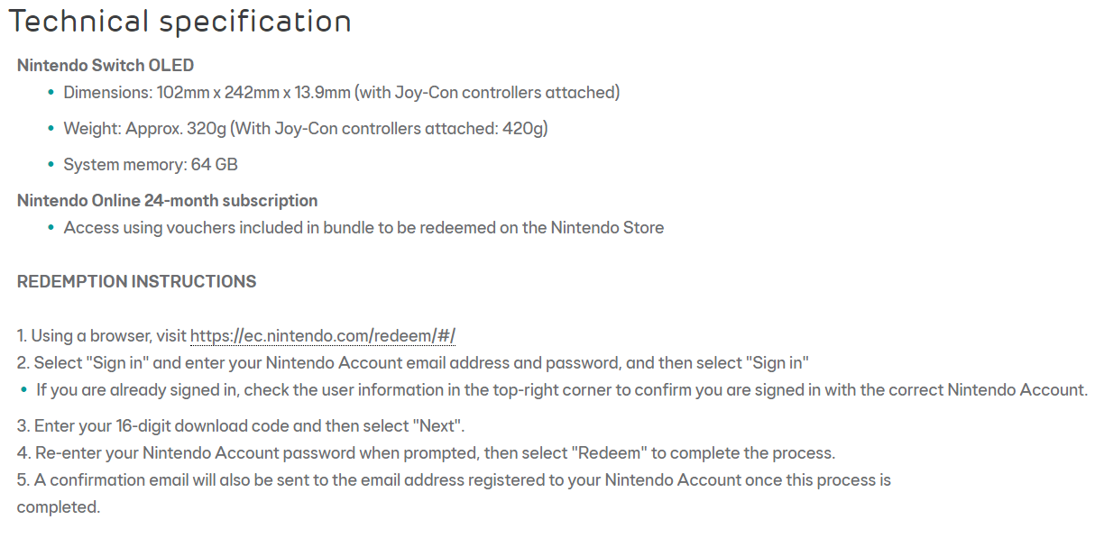

Slide 10
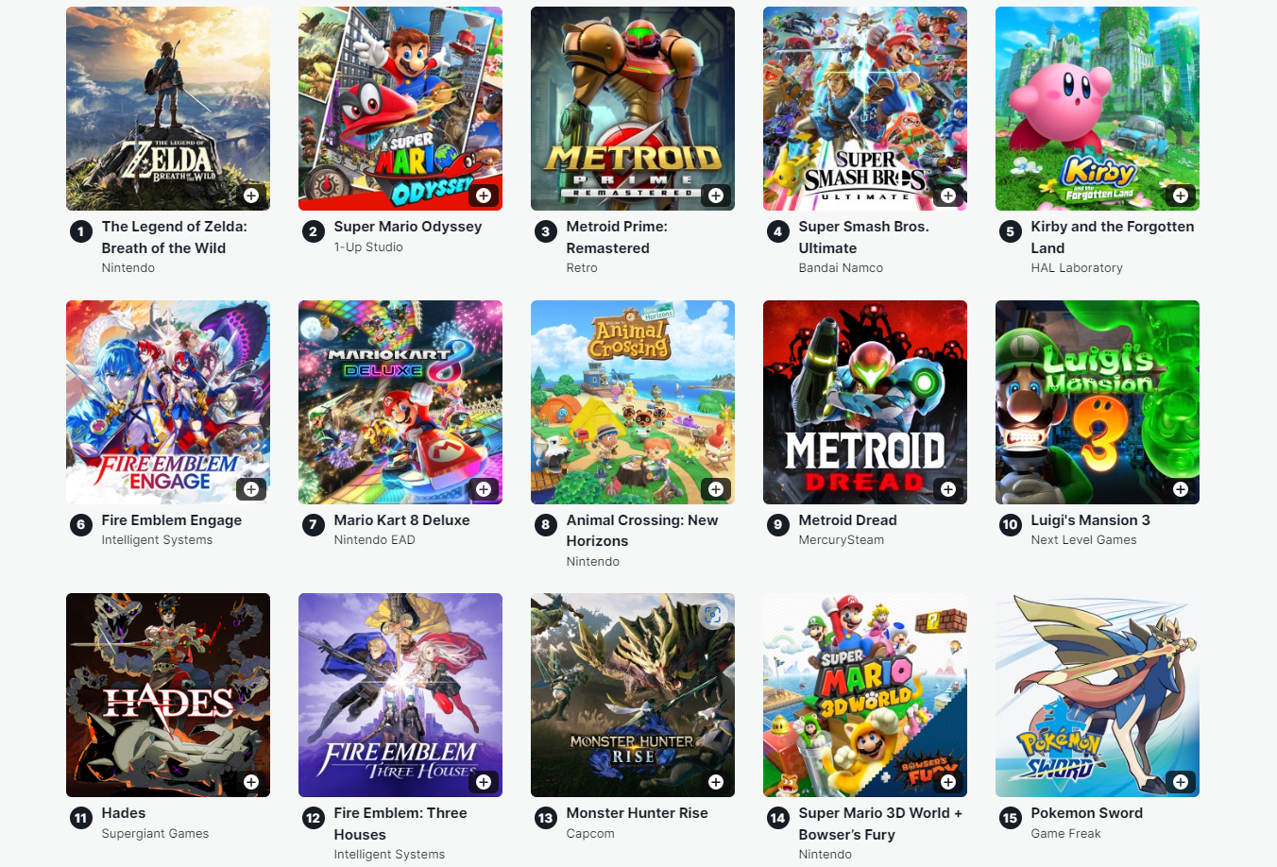
Top 15 Available Nintendo Switch Games 2023

